Slide 1
Atmospheric Oscillations
Shifting patterns
§9.4

Slide 2
Migration of the ITCZ
ITCZ roughly follows the subsolar latitude
Brings rainy season to tropical locations
Aw climate class

Slide 3
Migration of the ITCZ
Subtropical Highs follow the ITCZ
Tropical latitudes Aw: Dry in low-sun months
Mediterranean climates Cs: Dry in high-sun months

Slide 4
Aw Adaptations
Source: Aduna

Slide 5
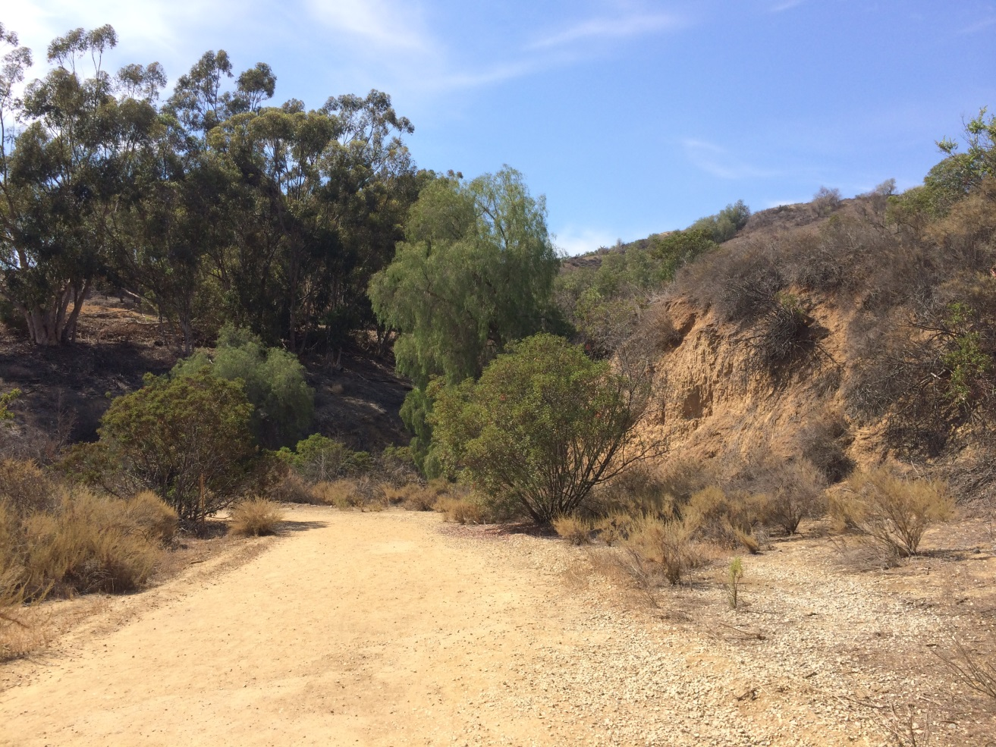
Cs Adaptations
By Gccwang - Own work, CC BY-SA 4.0, https://commons.wikimedia.org/w/index.php?curid=35076673

Slide 6
El Niño–Southern Oscillation (ENSO)
Normally trade winds drive surface waters from East to West
From Peru and Chile to Indonesia
Deep cold water upwells along Chilean coast
Nutrients for fish
Relatively little evaporation or humidity

Slide 7
El Niño–Southern Oscillation (ENSO)
During an El Niño event, this circulation declines
Fisheries decline
More rain in Chile
Less rain in Indonesia
Effects felt in distant locations
Flooding in California
Higher global surface temperatures

Slide 8
El Niño–Southern Oscillation (ENSO)
What makes it an “Oscillation?”
Repeats on an irregular scale, 3–7 years
Sometimes years of enhanced circulation
“La Niña”
NOAA Explanation

Slide 9
North Atlantic Oscillation
North Atlantic features the Iceland Low and Bermuda-Azores High
Variations in intensity changes weather patterns
Temperature in Eastern North American and Greenland
Rain in Western and Central Europe
Phases usually last several months

Slide 10
Madden-Julian Oscillation
Eastward moving disturbance in rain, wind, and pressure patterns
Suppressed rainfall leads, enhanced rainfall follows
Strongest in Pacific and Indian Ocean basins
Typical period 30–60 days

Slide 11
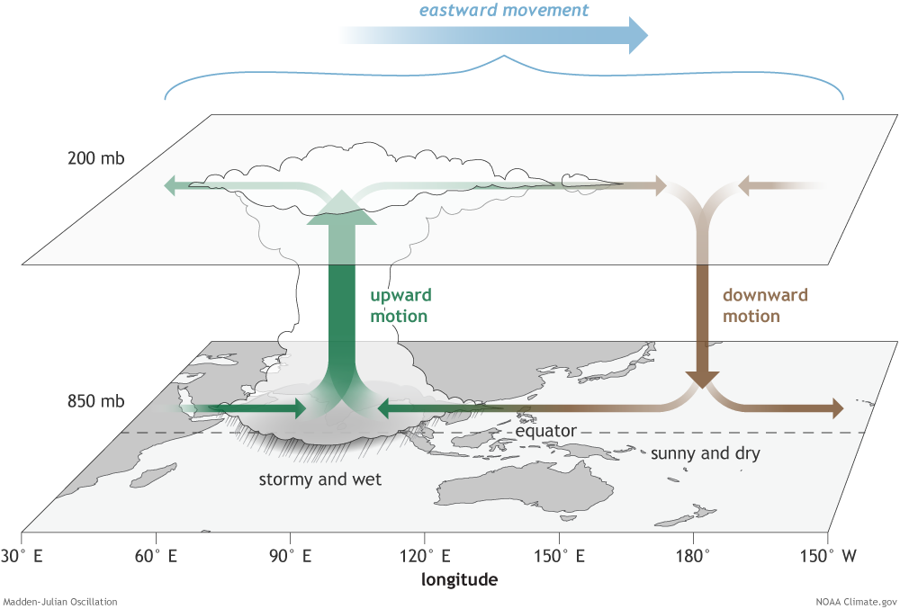
Madden-Julian Oscillation
Source: climate.gov

Slide 12
Madden-Julian Oscillation
Typical sequence graphic
Animation

