Slide 1
Air Pollution and Wind
How the weather affects pollution
§ 14.2

Slide 2
Dilution
“Dilution is not the solution to pollution.”
Dilution lessens the local impact of pollutants
At the cost of distributing them over a larger area

Slide 3
Dispersal
Wind disperses pollutants
Smokestacks keep it off the ground
Prevailing winds transport pollution
Jet streams are even faster
Cyclones lift pollutants to upper troposphere

Slide 4
Removal
Rain dissolves some gases and entrains particulates
OH radicals oxidize VOCs to CO₂ and H₂O

Slide 5
Concentration
Downslope breezes trap polluted air in valleys
Anticyclones keep air from rising
Also ensure sunny weather, facilitating photochemical smog

Slide 6
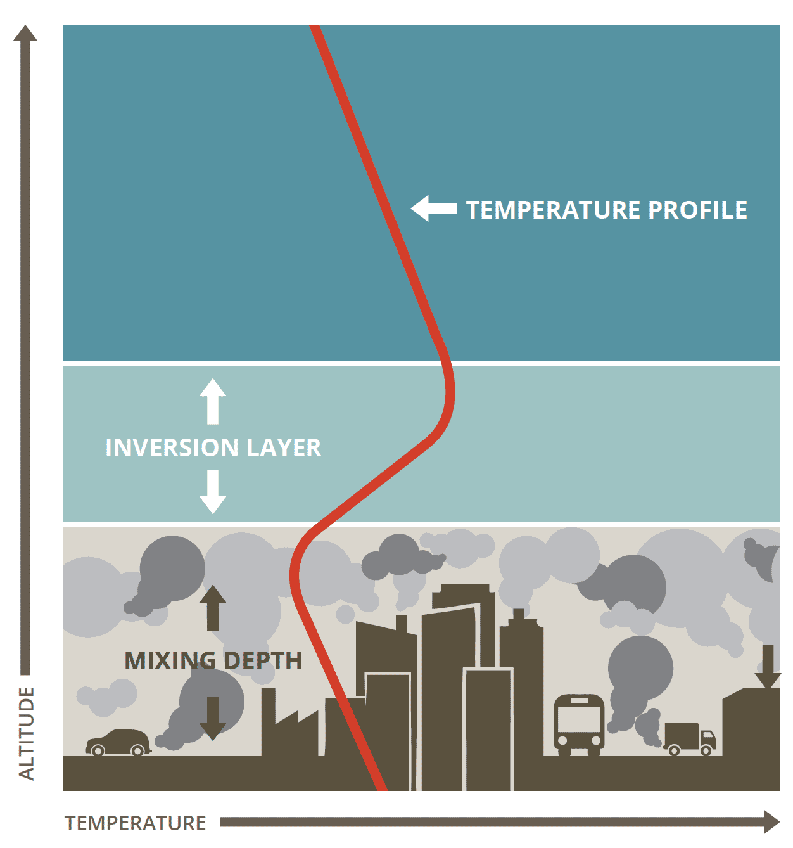
Inversion
Capping inversion
Unstable mixing layer

Slide 7
Where This Happens
Valleys
Especially surrounded by highlands
Los Angeles, Mexico City, Denver

