Slide 1
Request
Write your first and last name on the group work sheet so that I can find it on the roster

Slide 2
Reminders
Homework scores don’t figure into your course grade
Classwork scores don’t either
Homeworks are for practice
Homeworks should be open after their due dates

Slide 3
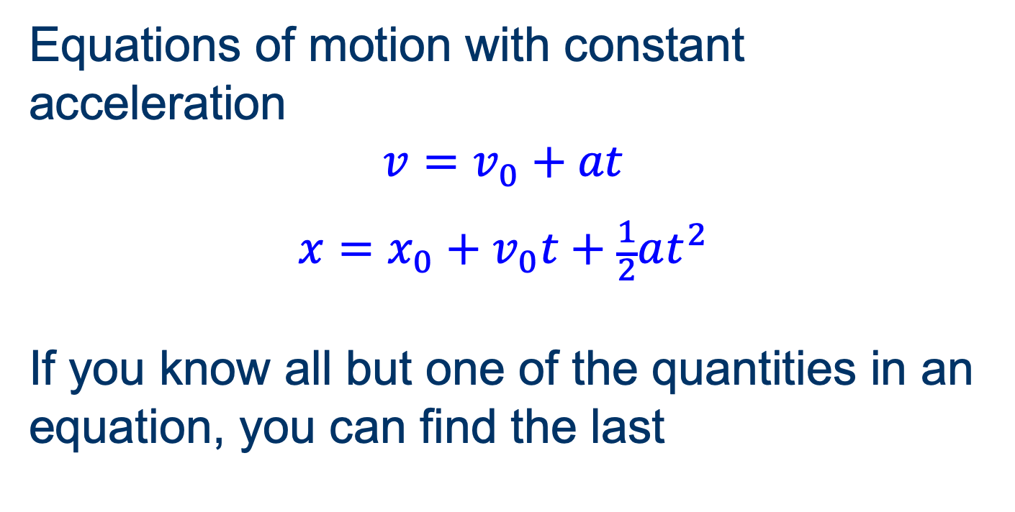
Review
Equations of motion with constant acceleration
$$v=v_{0}+at$$
$$x=x_{0}+v_{0}t+\frac{1}{2}at^{2}$$
If you know all but one of the quantities in an equation, you can find the last

Slide 4

Extension
Combine the two equations to eliminate t
$$v^{2}−v_{0}^{2}=2a(x−x_{0})$$

Slide 5

Extension
Combine the two equations to eliminate a
$$x−x_{0}=\frac{v_{0}+v}{2}t$$

Slide 6
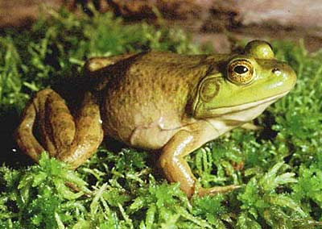
Eat a live bullfrog first thing in the morning…
…and nothing worse will happen to you for the rest of the day!

Slide 7
Unit Conversions
Always a matter of multiplying by 1
Example: Convert 72 inches to meters
1 m
72
72 in
= 72 in · 1
= 72 in ·
=
m
= 1.829 m
39.37 in
39.37
39.37 in = 1 m
equality
39.37 in
1 m
1
=
1
=
conversion factors
1 m
39.37 in

Slide 8

Vectors
More math concepts

Slide 9
Objectives
Distinguish between vector and scalar quantities.
Carry out addition, subtraction, and scalar multiplication of vectors.

Slide 10
What’s the Point?
How can we specify quantities that depend on direction?
How do such quantities combine?

Slide 11
Vectors and Scalars
Vector: quantity needing a direction to fully specify (direction + magnitude)
Scalar: directionless quantity

Slide 12
Physics Vectors and Scalars
Position, displacement, velocity, acceleration, and force are vector quantities.
Mass and time are scalar quantities.
(Yes, there are many others)

Slide 13
Arrows for Vectors
direction: obvious
magnitude: length
location is irrelevant
these are identical

Slide 14
Magnitude and Direction
Magnitude: How long, how fast, …
Direction: trigonometric convention is angle counterclockwise from +x axis

Slide 15
Cartesian Components
Components: projections in (x, y) directions
B
y
A = (4, 3)
x
A
B = (0, –2)

Slide 16
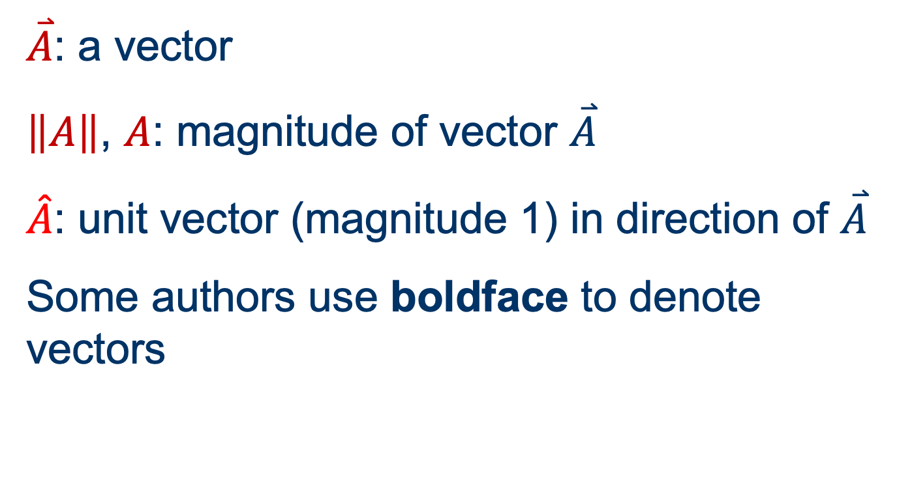
Notation
$\overset{⃑}{A}$: a vector
$\left\|A\right\|$, $A$: magnitude of vector $\overset{⃑}{A}$
$\hat{A}$: unit vector (magnitude 1) in direction of $\overset{⃑}{A}$
Some authors use boldface to denote vectors

Slide 17
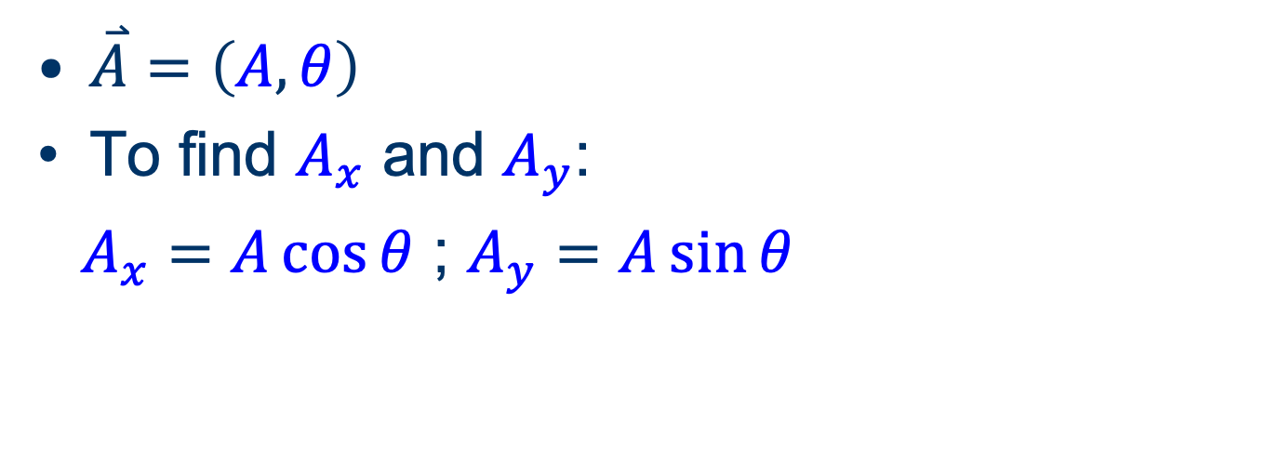
Polar to Cartesian
$\overset{⃑}{A}=\left(A, θ\right)$
To find $A_{x}$ and $A_{y}$:
$A_{x}=A\cos{θ}$ ; $A_{y}=A\sin{θ}$
y
A
A_{y}
θ
x
A_{x}

Slide 18
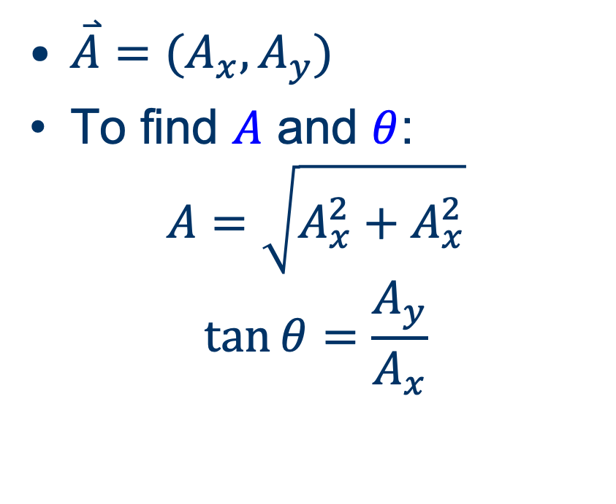
Cartesian to Polar
$\overset{⃑}{A}=(A_{x},A_{y})$
To find $A$ and $θ$:
$$A=\sqrt{A_{x}^{2}+A_{x}^{2}}$$
$$\tan{θ=\frac{A_{y}}{A_{x}}}$$
y
A
A_{y}
θ
x
A_{x}

Slide 19

Group work
Draw the vectors
  $\overset{⃑}{A}$ = (2.00 m/s, 5.00 m/s) and
  $\overset{⃑}{B}$ = (1.00 m/s. –3.00 m/s)

Slide 20
Add Vectors
Head-to-tail
A
A
C
B
B
A + B = C

Slide 21
Vector addition meaning
Displacements
Velocities
Forces

Slide 22

Group work
Graphically add the vectors $\overset{⃑}{A}$ and $\overset{⃑}{B}$ in the grid.

Slide 23
Adding by Components
Resultant: Add (x, y) components individually
A = (4, 3)
B
A
B = (0, –2)
C
C = A + B = (4+0, 3–2) = (4, 1)

Slide 24

Group work
Add vectors $\overset{⃑}{A}$ and $\overset{⃑}{B}$ by components.

Slide 25
Adding Vectors
If the vectors are is given in polar coordinates:
Convert both to Cartesian components
Add by components
Convert the sum to polar coordinates if the answer needs to be in polar coordinates

Slide 26
Question
Is vector addition commutative?
Yes.
No.

Slide 27
Vector Addition is Commutative
A
A + B = C
B
B + A = C
A + B = B + A

Slide 28
Respect the Units
For a vector sum to be meaningful, the vectors you add must have the same units!
Just as with scalars:
  5 s + 10 s = 15 s
good!
  5 kg + 10 m = 15 ?
Bad!
Or, algebra in general:
  5 a + 10 a = 15 a
good!
  5 b + 10 c = 15 ?
Bad!

Slide 29
Subtract Vectors
Add the negative of the vector being subtracted.
(Negative = same magnitude, opposite direction)
D
A
–B
B
–B
A
A – B = A + (–B) = D

Slide 30
Subtract Vectors
A – B = D means B + D = A
D
B
A

Slide 31
Multiplication by a Scalar
Product of (scalar)(vector) is a vector
The scalar multiplies the magnitude of the vector; orientation does not change
Direction reverses if scalar is negative
A
2 A
–2 A
1/2 A

Slide 32
Scalar Multiplication
Polar coordinates
  Multiply magnitude by the scalar
  Same angle (+ 180° if scalar is negative)
Components
  Multiply each component by the scalar

Slide 33
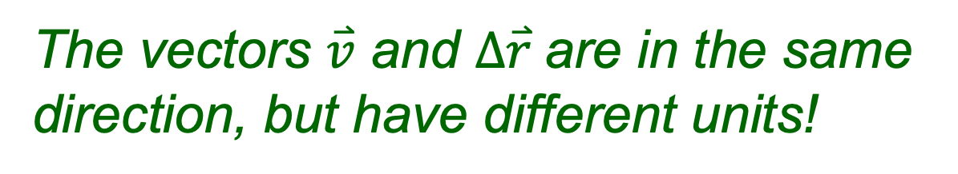
Typical Scalar Multiplication
Velocity (vector) × time (scalar)
v Δt = Δr
Result is displacement (vector).
The vectors $\overset{⃑}{v}$ and $∆\overset{⃑}{r}$are in the same direction, but have different units!

