Slide 1
Describing Motion
in 3-D
§3.1
(and 2-D)

Slide 2
Question
Two objects can travel at the same speed but have different velocities.
True
False

Slide 3
Question
Two objects can travel at the same velocity but have different speeds.
True
False

Slide 4
Vectors
Position is a vector
Velocity is a vector
Acceleration is a vector

Slide 5
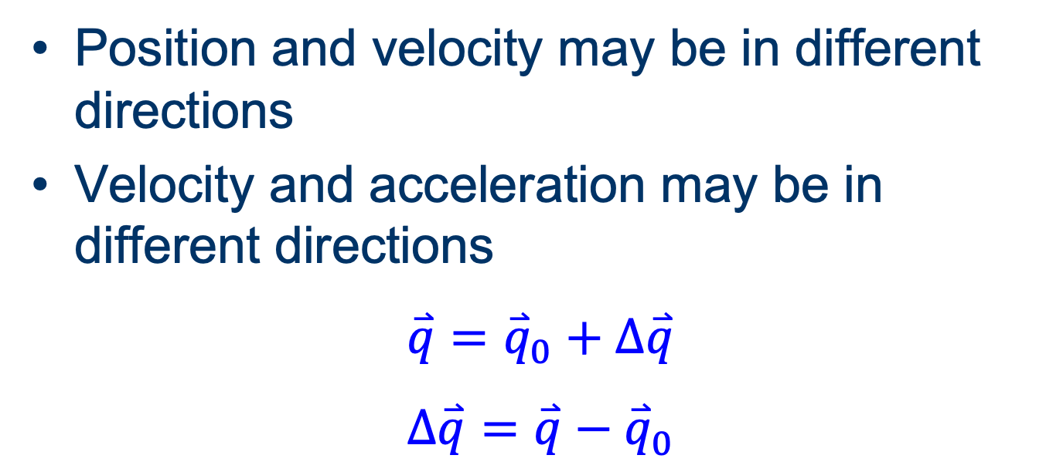
Change Vectors
Position and velocity may be in different directions
Velocity and acceleration may be in different directions
$$\overset{⃑}{q}={\overset{⃑}{q}}_{0}+∆\overset{⃑}{q}$$
$$∆\overset{⃑}{q}=\overset{⃑}{q}−{\overset{⃑}{q}}_{0}$$

Slide 6
Position and Displacement
Position is where something is
  r = (x, y, z)
Displacement is difference in position
  Δr = (Δx, Δy, Δz)
Distance is the magnitude of displacement.

Slide 7
Question
It is possible to travel along a winding path at a constant speed.
True
False

Slide 8
Question
It is possible to travel along a winding path at a constant velocity.
True
False

Slide 9
Velocity and Acceleration
Velocity v = rate of change of r
  average v_{avg} = Δr/Δt
    t is scalar; v_{avg} and Δr are same direction
  instantaneous v = lim Δr/Δt
Δt 0
Speed is the magnitude of velocity.
Acceleration a = rate of change of v
  Average a_{avg} = Δv/Δt
  instantaneous a = lim Δv/Δt
Δt 0

Slide 10
Denoting 3-Vectors
Position r = (x , y , z)
Velocity v = (v_{x} , v_{y}, v_{z})
Acceleration a = (a_{x} , a_{y}, a_{z})

Slide 11
Magnitudes of 3-Vectors
Distance from origin
r = | r | = x² + y² + z²
Speed v = | v | = v_{x}² + v_{y}² + v_{z}²
Magnitude of acceleration
a = | a | = a_{x}² + a_{y}² + a_{z}²

Slide 12
Familiar Situations
Ballistic trajectories
Circular motion
If a || v, path is straight.
If a || v, path is curved.

Slide 13
Question
If an object’s distance from the origin r does not change, its velocity must be zero.
True.
False.

Slide 14
Question
If an object’s speed v does not change, its acceleration must be zero.
True.
False.

Slide 15
Acceleration and Velocity
The component of a parallel to v causes the speed to change.
The component of a perpendicular to v causes the direction to change.

Slide 16
Question
The rate of change of an object’s speed is the same as the magnitude of its acceleration.
Always.
Sometimes.
Never.

