Slide 1
Newton’s laws
What are forces?
What do they do?

Slide 2
What’s the point?
What makes things move, stop, or change direction?
Are these even the right questions?
Notes:
2

Slide 3
Group Work
What is a force?
Is a force a vector, a scalar, or something else?
What is the role of force in motion?

Slide 4
Force
A push or pull
Chapter 4
Notes:
4

Slide 5
Force
Forces are vectors
Magnitude: How hard? How strong?
Direction: Which way?

Slide 6
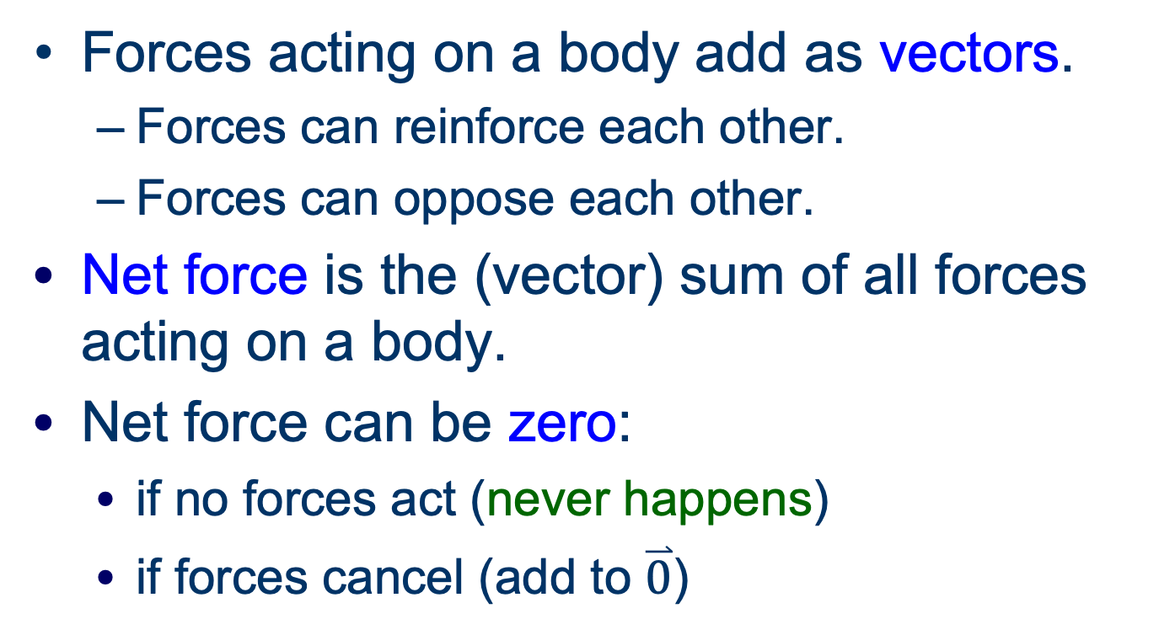
Net Force
Forces acting on a body add as vectors.
  Forces can reinforce each other.
  Forces can oppose each other.
Net force is the (vector) sum of all forces acting on a body.
Net force can be zero:
  if no forces act (never happens)
  if forces cancel (add to $\overset{⃑}{0}$)

Slide 7
Newton’s First Law
the law of inertia
Notes:
7

Slide 8
What’s the point?
What is the natural tendency of motion?
What governs an object’s motion?

Slide 9
Aristotle’s View
Things tend to their natural state
  Fire and air: up
  Earth and water: down
  Heavens: perfect circles
Exceptions: “Violent motion” requires force

Slide 10
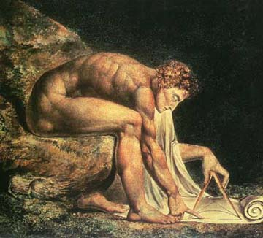
Newton’s First Law
An object’s velocity does not change unless a nonzero net force acts upon it.
If at rest, it remains at rest.
If moving, it continues straight at constant speed.
Representation of Newton by William Blake, 1795

Slide 11
Does it Make Sense?
Do you feel a force while cruising in a plane? A train? An automobile?
If you were moving in a perfectly straight line at a constant velocity inside a closed box, could you tell?

Slide 12
What does Newton’s first law mean?
Being at rest is nothing special; it is just another value (zero) of constant velocity.
rest
constant velocities

Slide 13
What does Newton’s first law mean?
Aristotle’s notions of natural position and violent motion are mistaken
Changing velocity, not position, requires intervention
Notes:
13

Slide 14
Equivalent Statement
Newton’s first law:
ΣF = 0 ⇔ a = 0
Zero net force means constant velocity
Constant velocity means zero not force

Slide 15
Converse
Equilibrium Rule: An object with a constant velocity experiences zero net force.
That means that the forces acting on it all add to zero.
A body with zero net force is in mechanical equilibrium.
Notes:
15
A box sitting on the table ;obviously zero net force.
Pushing on the table without moving it - also zero net force.
Pushing at a constant speed - zero net force! Really! Recall planes, trains, and automobiles.

Slide 16
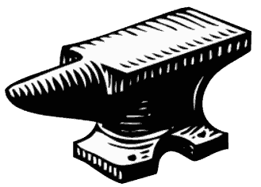
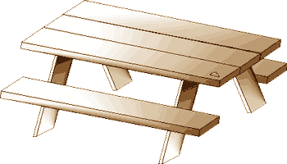
Example
Gravity pushes the anvil down.
The table pushes the anvil up.
zero net force

Slide 17
Newton’s Second Law
When net force isn’t zero
Notes:
17

Slide 18
What’s the point?
How do forces affect motion quantitatively?
Notes:
18

Slide 19
Experience Tells Us
The greater the net force on an object, the more it accelerates.
The greater the mass of an object, the harder it is to accelerate.
Notes:
19

Slide 20
Newton’s Second Law
ΣF
a =
m
equivalently,
ΣF = ma
a = acceleration
ΣF = net force
m = mass
Notes:
20

Slide 21
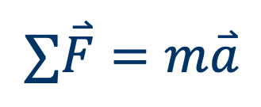
Quantify Force
Unit of force: 1 newton (N) = force needed to accelerate 1 kg at 1 m/s²
How much is a newton?
kg m
$$∑\overset{⃑}{F}=m\overset{⃑}{a}$$
= (1 kg) (1 m/s²)
= 1
s²
Notes:
21

Slide 22
Net Force and Acceleration
Always in the same direction!
a = ΣF/m
m > 0 always

Slide 23

Group work
A 0.750-kg bowl of petunias falls at the rate of 9.8 m/s². What is the net force acting on it?
image stolen from Zell Wood on Tumblr

Slide 24
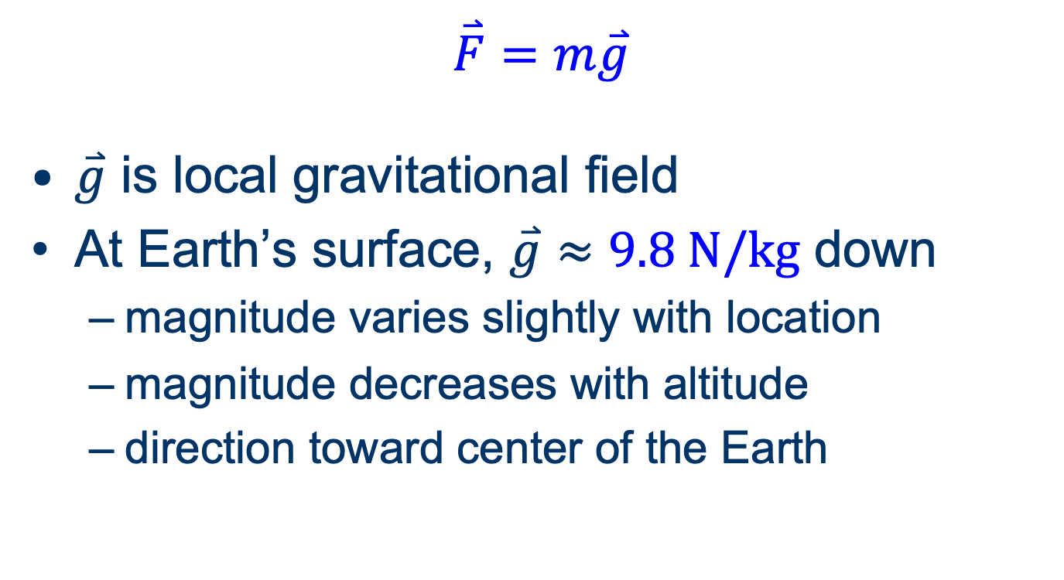
Force of weight
$$\overset{⃑}{F}=m\overset{⃑}{g}$$
$\overset{⃑}{g}$ is local gravitational field
At Earth’s surface, $\overset{⃑}{g}≈9.8 \text{N}\text{/}\text{kg}$ down
  magnitude varies slightly with location
  magnitude decreases with altitude
  direction toward center of the Earth

Slide 25
Group work
A blacksmith’s anvil has a mass of 45 kg. What is its weight in newtons?
What is the magnitude and direction of the force exerted by the table on the anvil?

Slide 26
Newton’s third law
Nothing acts alone

Slide 27
Question
If a 0.25-g insect collides with a 1250-kg compact car, which experiences the greatest (magnitude of) force in the collision?
The insect.
The car.
It’s a tie.
Insufficient information to answer.

Slide 28
Newton’s Third Law
To every action there is an equal and opposite reaction.
If object A exerts force F on object B, object B exerts force –F on object A, along the same line of interaction.
F_{A→B} = –F_{B→A}
Notes:
Demonstrate rope and skateboard

Slide 29
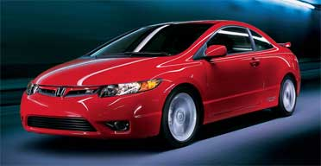
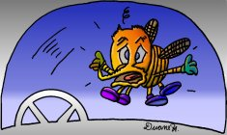
Bug + Windshield
Small car: 1250 kg
Large insect: 0.00025 kg
From the same force, the bug accelerates a lot more!

Slide 30
Interaction Forces
All forces are interaction forces!
  gravity
  wind
  jumping
  everything!
This means: whenever something accelerates, something else accelerates in the opposite direction!
Whoa!

Slide 31
Group work
A basket of peaches weighing 12.0 N sits on a table.
exerts a downward force of 12.0 N on the basket.
exerts an upward force of 12.0 N on the basket.
The basket exerts a downward force of 12.0 N on .
The basket exerts an upward force of 12.0 N on .

Slide 32
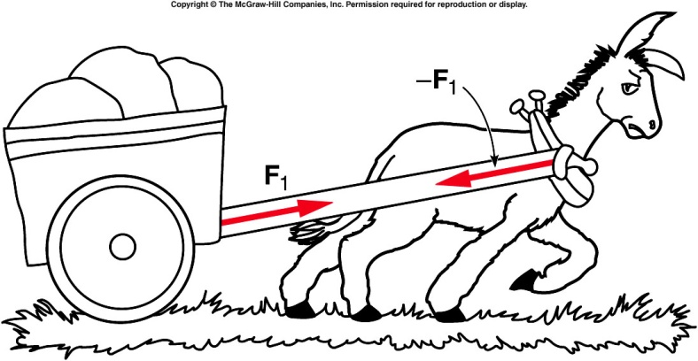
Group Question
Your educated mule argues that there is no point in pulling a cart, because the cart will pull back on him as hard as he pulls on it. What should you tell him?
Oh, sorry, you’re right.
It won’t, trust me.
The cart’s pull isn’t the only force on you.
It has to work. Newton must be wrong.

