Slide 1
Forces
in Newton’s second law

Slide 2
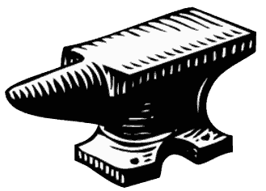
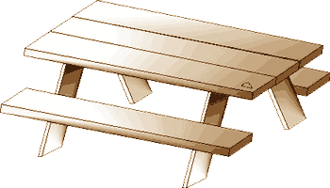
Normal Force
Exerted by a surface perpendicular (normal) outward
Magnitude as needed to cancel inward forces
Force of constraint
normal
zero net force
weight
weight
weight

Slide 3
Free Body Diagrams
Forces on one object

Slide 4
Objective
Construct an object’s force diagram consistent with its physical circumstances.

Slide 5
What’s the point?
How can we inventory an object’s forces?
How can we check that our model considers the correct forces?

Slide 6
Free body diagrams
To find net force ⇒ acceleration
Diagram covers only the body and the forces acting on it

Slide 7
Free body diagrams
Vector arrows directed outward from object
Indicate every force on it!

Slide 8
Question
How many forces act on the anvil?
zero net force

Slide 9
Question
How many forces act on the table?
zero net force

Slide 10
Combining Forces
What are the forces on the anvil? Table?
Free-body diagrams for them?
zero net force

Slide 11
Anvil
Support from table
Its weight
Net force ∑F = 0

Slide 12
Table
support from ground
its weight
anvil’s weight
Net force ∑F = 0

Slide 13
Tension
in cables, ropes, chains, etc

Slide 14
Tension
Acts inward along the cable
Often a force of constraint
inextensible cable
Constant distance between ends

Slide 15
Example
weight
1 m
F
F
8 m
A hammock slung between trees 8 m apart sags 1 m when a person lies in it. What is the tension of each rope holding the hammock?
First, claim what you expect.
Equal to the weight of the person.
Half the weight of the person.
More than the weight of the person.
Less than the weight of the person, but more than half.

Slide 16
Pulleys
Assumed frictionless
Re-direct tension
Maintain magnitude
m
Tension is mg in every segment of the cable

Slide 17
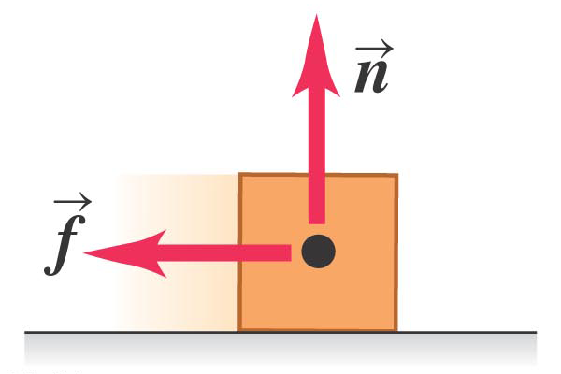
Friction
another surface force
parallel to the surface, opposing sliding
Source: Young and Freedman, Figure 4.2 b

Slide 18
Friction
Commonplace but complicated
Surface friction acts parallel to a surface
Friction f opposes applied sliding force F
N
perpendicular (normal) force
F
f

Slide 19
Friction
N
perpendicular (normal) force
F
f
f ≈ μN (directions of f and N are different)
μ = coefficient of friction
Coefficient μ depends only on surface materials, not mass, weight, area of contact, sliding speed (one exception).

Slide 20
Friction
Static friction: when the two surfaces are not moving past each other
Kinetic friction: the two surfaces slide along each other
Static friction > kinetic friction

Slide 21
Group Question
Rank the magnitude of frictional force on a car in these different situations.
Skidding on dry pavement.
Skidding on ice.
Braking just short of a skid on dry pavement.

Slide 22
Static vs. Kinetic Friction
Start pushing an object
Anti-lock brakes
Learning to drive
Stick-slip motion

Slide 23
Example problem
A worker tries to drag a 40.-kg crate on a level floor by attaching a rope to one edge and pulling with an upward and forward tension at 35°above horizontal. The coefficients of friction are µ_{s} = 0.50 and µ_{k} = 0.40.
T
What is the minimum tension needed to move the crate?
What is the crate’s acceleration if that force is maintained?
What is the maximum force at which this model applies?

