Slide 1
Collisions
basically include every interaction

Slide 2
Classes
Elastic: kinetic energy is conserved
  No energy transfer to internal motion
Totally inelastic: objects couple upon collision
Inelastic: total K less after
Push-apart: objects provide additional repulsion
Momentum is conserved in all types

Slide 3
Derivation
Initial conditions m₁, v₁, m₂, v₂
What is final velocity v_{f} of a totally inelastic (v_{1f} = v_{2f} = v_{f}) collision?

Slide 4
Totally Inelastic Collision
m₁v₁ + m₂v₂ = m₁v + m₂v
Σp = (m₁ + m₂)v
Σp
v =
Σm

Slide 5
Question
A cart traveling to the left collides with a cart of equal mass initially stationary but free to move. The collide totally inelastically and stick together. What is the final velocity of the combined carts?
v
m
m
Notes:
total p = –MV
final v = p/(2M) = –MV/(2M) = –V/2

Slide 6
Question
Two cars of equal mass are traveling opposite directions at speed v. They collide totally inelastically and stick together. What is the final speed of the combined smashed mass?
v
v
m
m
Notes:
final v = 0

Slide 7
Question
Two cars of unequal mass travel at different speeds in opposite directions as indicated. They collide totally inelastically and stick together. What is the final velocity of the vehicle on the left?
v
2v
m
2m
Notes:
Total p = MV + (2M)(–2V) = MV – 4MV = –3MV
final v = p/(3M) = (–3MV)/(3M) = –V

Slide 8
Elastic Collision in 1 Dimension
Conservation of momentum
m₁v_{1i} + m₂v_{2i} = m₁v_{1f} + m₂v_{2f}
Conservation of kinetic energy
½ m₁v_{1i}² + ½ m₂v_{2i}² = ½ m₁v_{1f}² + ½ m₂v_{2f}²
Two equations in two unknowns

Slide 9
1-D Elastic Collision Outcomes
m₁−m₂
2m₂
v_{1f} =
v_{1i}
+
v_{2i}
m₁+m₂
m₁+m₂
m₂−m₁
2m₁
v_{2f} =
v_{2i}
+
v_{1i}
m₁+m₂
m₁+m₂

Slide 10
Question
Two cars of equal mass are traveling opposite directions at speed v. They collide completely elastically. What is the final velocity of the car on the left?
v
v
m
m
Notes:
final v = –v for the car on the left, +v for the car on the right

Slide 11
Example Problem
A car traveling to the left collides with a car of equal mass initially stationary but free to move. The collide completely elastically. What is the final velocity of the initially stationary car?
v
m
m

Slide 12
Example Problem
Two asteroids of equal mass collide with a glancing blow. Asteroid A, which was initially traveling at 40.0 m/s, is deflected 30.0° from its original direction, while asteroid B, which was initially at rest, travels at 45.0° to the original direction of A.
A
30°
A
B
45°
Find the speed of each asteroid after the collision.
What kind of collision is this?
What fraction of the original kinetic energy of asteroid A is lost during the collision?

Slide 13
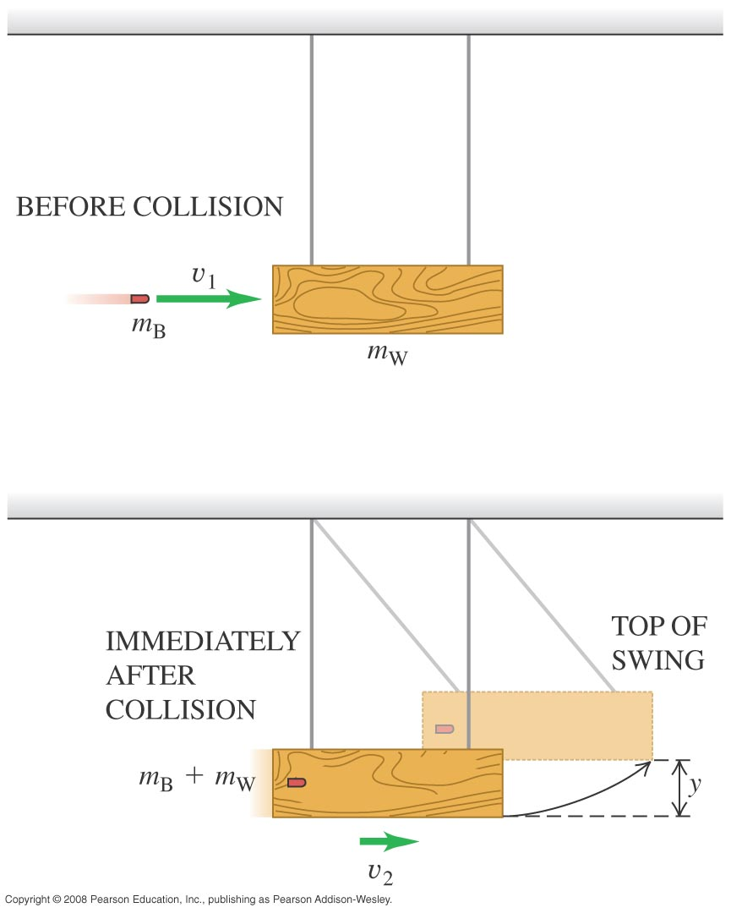
Example Problem
A 12.0-g rifle bullet is fired with a speed of 380 m/s into a wood block pendulum with mass 6.00 kg, suspended from two cords 70.0 cm long. The bullet embeds in the block, and the block swings upward after impact.
What kind of collision is this?
Find the kinetic energy of the bullet and pendulum immediately after the bullet becomes embedded in the pendulum.

Slide 14
Example Problem
A 12.0-g rifle bullet is fired with a speed of 380 m/s into a wood block pendulum with mass 6.00 kg, suspended from two cords 70.0 cm long. The bullet embeds in the block, and the block swings upward after impact.
Find the vertical height through which the pendulum rises.
What fraction of the initial kinetic energy of the system was lost in the collision?

Slide 15
Center of Mass
when sets act like single particles
§ 8.2.1

Slide 16
Center of Mass
Location of center of mass:
weighted average of particle positions
r_{cm} = Σm_{i}r_{i}/Σm_{i}

Slide 17
Center of Mass
Velocity of center of mass:
Rate of change of position
v_{cm} = ∆(Σm_{i}r_{i}/Σm_{i})/∆t
= Σm_{i}(∆r_{i}/∆t)/Σm_{i}
= Σm_{i}v_{i}/Σm_{i}
= p_{tot}/m_{tot}

Slide 18
Systems of Particles
A net external impulse changes total momentum
v_{cm} changes accordingly

Slide 19
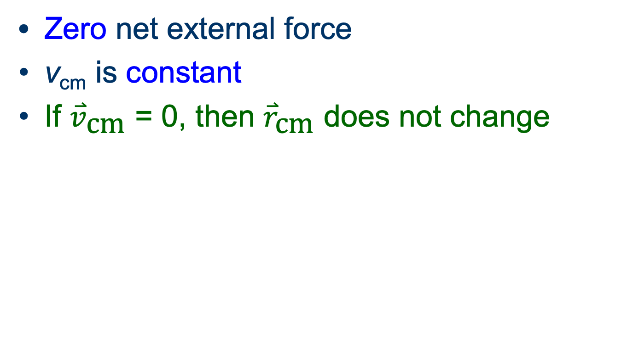
Isolated System

Slide 20
Question
Two joined cars of mass m and 2m are at rest liked by a compressed spring that is released. After the spring fires, one car moves off to the right and the other to the left. The car initially on the left has a speed that is
m
2m
Zero.
equal to the one on the right.
one half the speed on the right.
twice the one on the right.

Slide 21
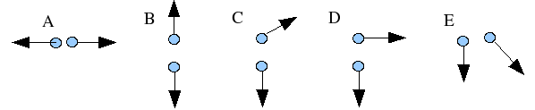
Question
A firework shell is launched vertically into the air and at the top of its trajectory an explosive charge breaks the shell into two pieces. In which directions is it possible for the two pieces to move? The pieces do not necessarily have equal mass and the arrow indicate only the direction of the velocity, not the magnitude.
A only
A or B
A, B, or C
A,B,C, or D
All of the above are possible
None of the above are possible

Slide 22
Example Problem
A fireworks rocket is fired vertically upward. At its maximum height of 80 m it explodes and breaks into two pieces of mass 1.4 kg and 0.28 kg. In the explosion 860 J of chemical energy is released and converted into kinetic energy of the fragments.
What is the speed of each fragment?
If they hit the ground at the same time, what is the distance between them?

Slide 23
CM Reference Frame
It is often convenient to analyze interactions in the reference frame based on the center of mass.
Total momentum is zero
Particle momentums equal and opposite
Speeds inversely proportional to masses
Speeds constant in elastic collisions

