Slide 1
Torque
rotational influence

Slide 2
Objectives
Determine the torque applied by a force about an axis.
Predict an object’s response to a torque.

Slide 3
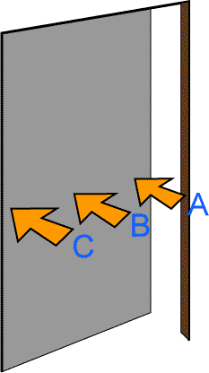
Question
You push on a door. It will open easiest if you push
opposite the hinge.
at the center of the door.
Next to the hinge.

Slide 4
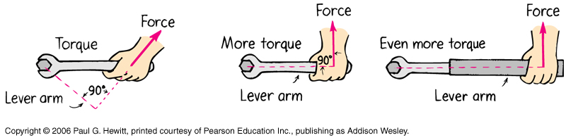
Torque
Turning influence = torque
= lever arm × force
= r × F
Units: Nm (not J)

Slide 5
Vector Cross Product
Operation symbol ×
Another way to multiply two vectors
Product is a vector!
Direction of A×B is perpendicular to both A and B

Slide 6
Cross Product Magnitude
a
⏐A × B⏐ = ab sin θ
A
θ
Maximum for θ = 90°
Zero for θ = 0°, 180°
B
b

Slide 7
Magnitude Geometrically
a
A
θ
B
b
⏐A×B⏐ = area of parallelogram

Slide 8
Cross Product Direction
Curl right-hand fingers in direction of θ
Right-hand thumb points in direction of cross-product
Not commutative
a
A
θ
B
b
A×B = –(B×A)

Slide 9
Radius Vector
Vector from reference point to application of force
Usually, the point is an axis of rotation
Torque depends on your choice of point!

Slide 10
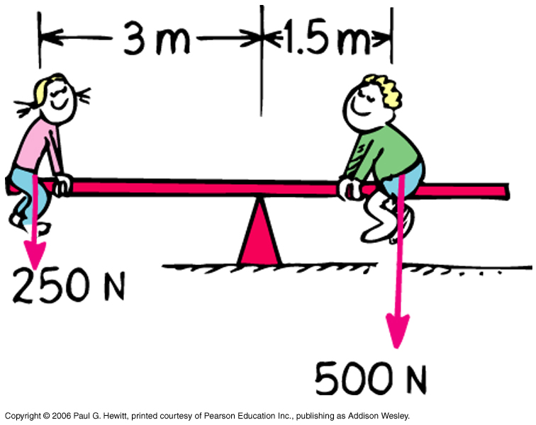
Adding Torques
750 N
Net torque about fulcrum is zero here
Torques are vectors

Slide 11
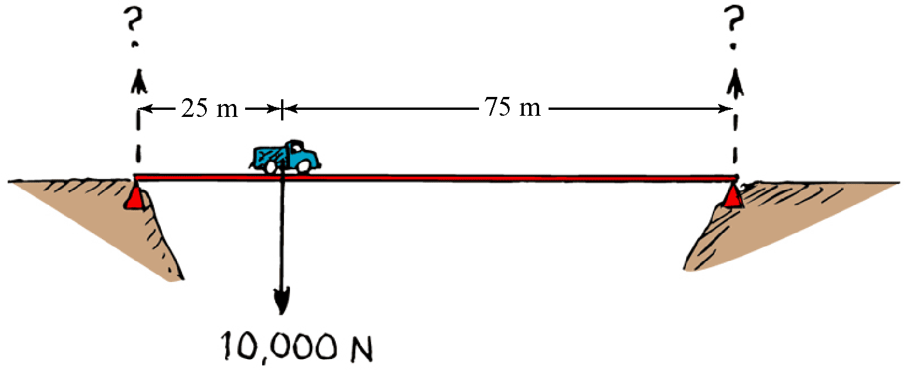
Example
A 10,000-N truck is stalled 1/4 of the way across a 100-m bridge. What torque does its weight apply about the right post?
r

Slide 12
Example
What upward force must the left post exert to cancel the truck’s torque about the right post?
r
F

Slide 13
Group Work
What additional upward force must the right post exert to support the weight of the truck?
Hint: Several ways will work:
canceling forces on the bridge
canceling torques about the near support
r
F

Slide 14
Lever Arm
Component of r perpendicular to F
l
r
θ
F
⏐r × F⏐ = area of parallelogram
= lF = area of rectangle

Slide 15
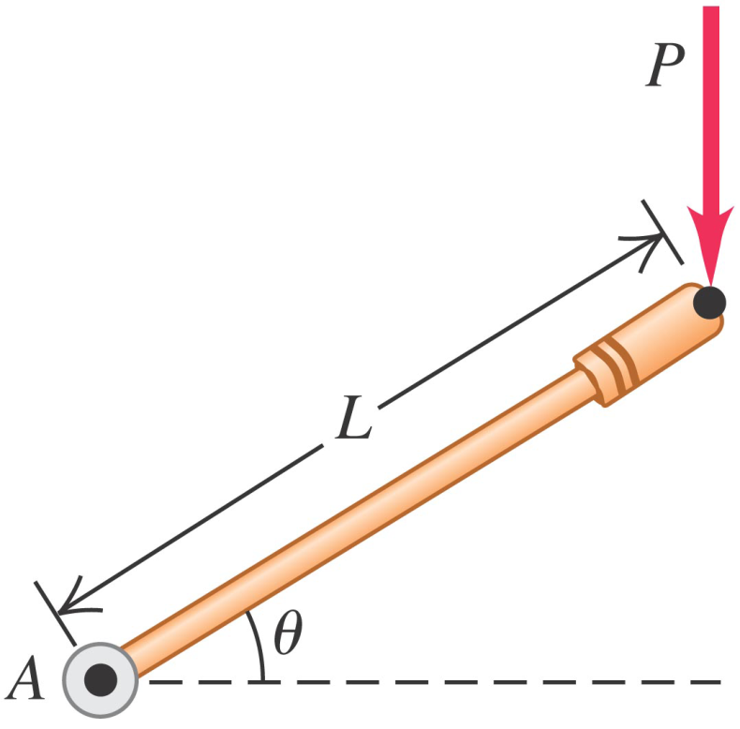
Group Question
Force P is applied to the end of a lever of length L. What is the magnitude of the torque about the axis A?
PL sin θ.
PL cos θ.
PL tan θ.
PL sec θ.
PL cot θ.
PL csc θ.
Source: Young and Freedman, Test Your Understanding §10.1

Slide 16
Center of Gravity
Where weight vector would be applied to duplicate torque of weight
In a uniform gravitational field, same place as center of mass

