Slide 1
Question
The period of a spring simple harmonic oscillator depends on:
The spring constant k.
The mass m.
The maximum amplitude A.
The gravitational field g.

Slide 2
Pendulums
almost follow Hooke’s law
§ 13.5

Slide 3
Angular Oscillators
Angular Hooke’s law:
τ = –κθ
Angular Newton’s second law:
τ = Iα
So
–κθ = Iα
General Solution:
θ = Θ cos(ωt + φ)
where ω² = κ/I; Θ and φ are constants

Slide 4
Simple Pendulum
L
θ
m
Massless, inextensible string/rod
Point-mass bob
Notes:
4

Slide 5
Question
The period of a simple pendulum depends on:
The length L.
The mass m.
The maximum amplitude Θ.
The gravitational field g.

Slide 6
Simple Pendulum Force
L
T = w_{R} + mv²/L
θ
w_{R} = mg cosθ
w = mg
θ
m
w⊥ = mg sinθ
ΣF⊥ = –w⊥ = –mg sinθ

Slide 7
Simple Pendulum Torque
ΣF_{T} = –w_{T} = –mg sinθ
= LF_{T} = –L mg sinθ
Restoring torque
L
θ
m
Notes:
7

Slide 8
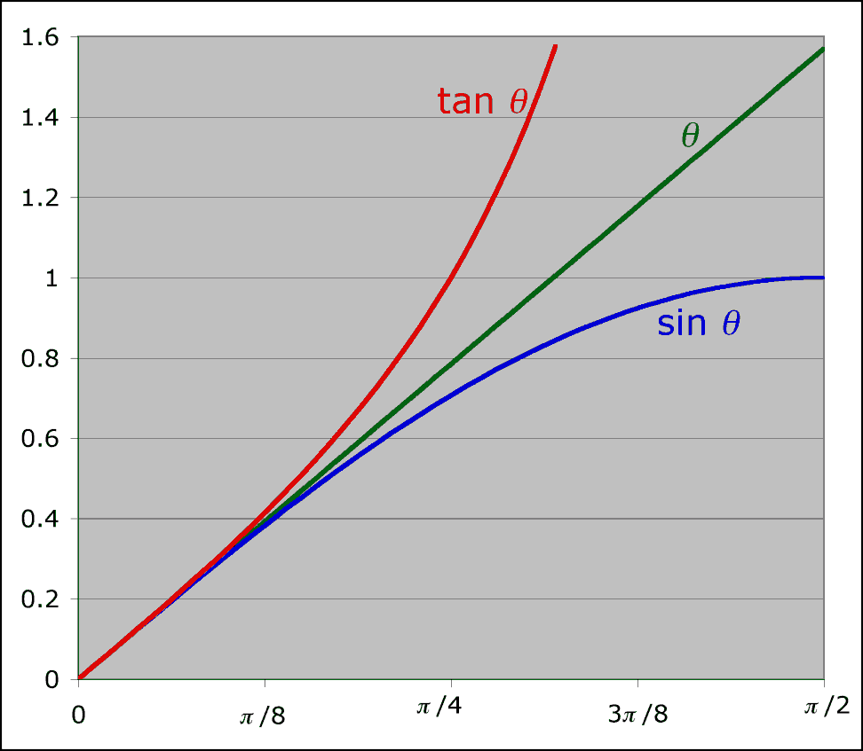
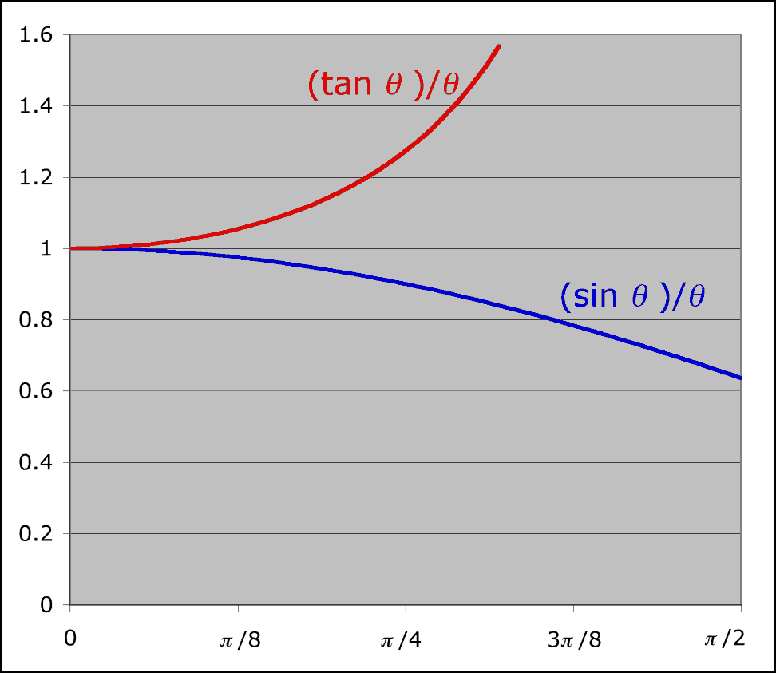
Small Angle Approximation
For small θ (in radians)
θ ≈ sin θ ≈ tan θ

Slide 9

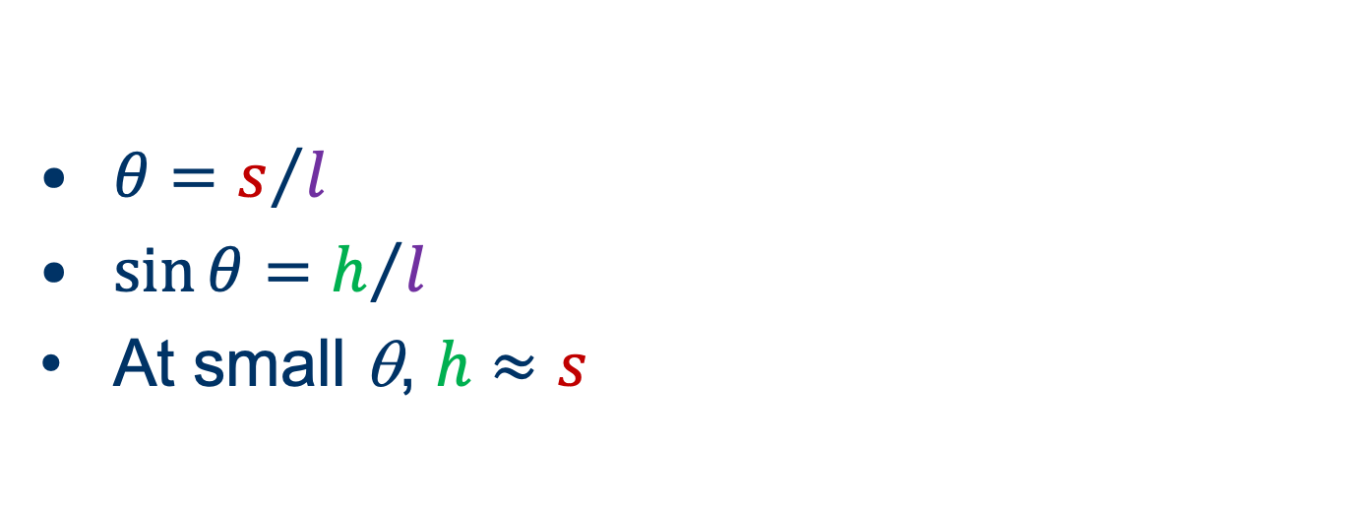



Small Angle Approximation
$$l$$
$$s$$
$$h$$
$$θ$$
$θ=s/l$
$\sin{θ}=h/l$
At small θ, $h≈s$

Slide 10
Simple Pendulum
τ = –L mg sinθ
τ ≈ –L mg θ = –κθ
κ = Lmg
I = mL²
L
θ
Lmg
m
ω² = κ/I =
= g/L
mL²
ω is independent of mass m
(ω is not the angular speed of the pendulum)
Notes:
10

Slide 11
Group Work
Find the length of a simple pendulum whose period is 2 s.
About how long is the pendulum of a grandfather clock?

Slide 12
Physical Pendulum
Bob is an extended object rather than a point mass
Swinging the pendulum means rotating the bob
Rotational inertia opposes changing the bob’s angular momentum

Slide 13
Moment of Inertia
Point mass
ML²
Extended object
ML² + I_{cm}
L
L
M
M
I_{cm}

Slide 14
Question
An extended object with its center of mass a distance L from the pivot, has a moment of inertia
greater than
the same as
less than
a point mass a distance L from the pivot.

Slide 15
Question
If a pendulum has a large moment of inertia, its period is
longer than
the same as
shorter than
the period of a pendulum with a smaller moment of inertia.
Notes:
15

