Slide 1
Orbital Mechanics
Gravity, Energy, and Angular Momentum

Slide 2
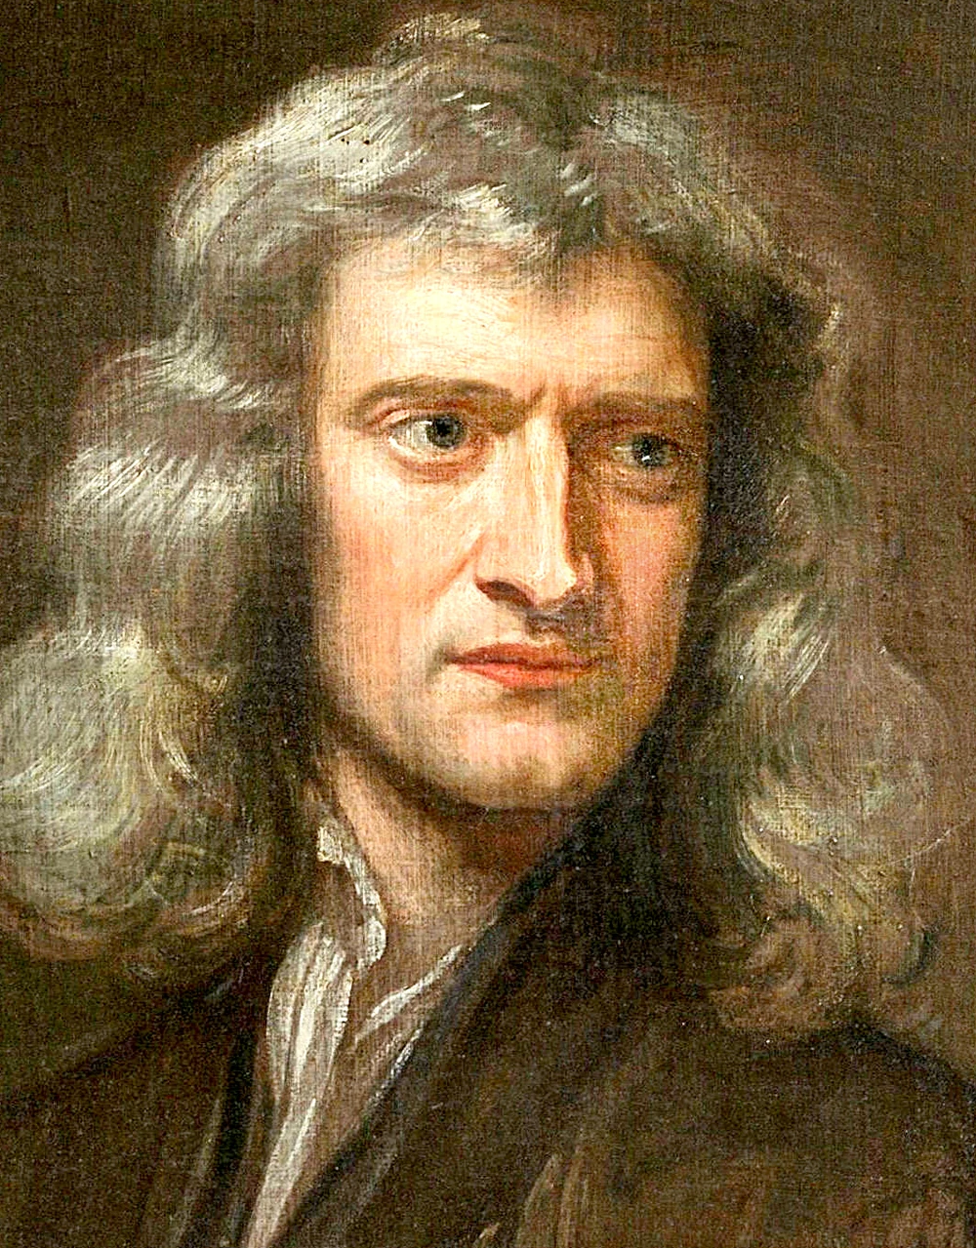
Gravitational Potential Energy
for real this time

Slide 3
Historical Background
Earthly and celestial objects thought fundamentally different
  Earthly objects seek a lowly position
  Celestial objects move in perfect circles

Slide 4
Newton’s Insight
The force pulling us to the ground is the same force curving the moon’s path: gravity!

Slide 5
Newton’s Law of Universal Gravitation
Force between two objects:
m₁m₂
F = G
d²
m₁, m₂: masses of the objects
d: distance between objects’ centers of mass
G: universal gravitational constant,
6.672 × 10^{–11} Nm²/kg²

Slide 6
Properties of Gravity
m₁m₂
F = G
d²
direction is toward the other object
magnitude decreases as (distance)² increases
never becomes zero
infinite at zero separation (?!)

Slide 7
Poll Question
The planet Saturn is about 10 times farther from the Sun than Earth. Its mass is about 100 times that of earth. How does its gravitational attraction to the Sun compare to Earth’s?
100 times weaker.
10 times weaker.
About the same.
10 times stronger.
100 times stronger.

Slide 8
Poll Question
The planet Saturn is about 10 times farther from the Sun than Earth. Its mass is about 100 times that of earth. How does its gravitational acceleration toward the Sun compare to Earth’s?
100 times smaller.
10 times smaller.
About the same.
10 times larger.
100 times larger.

Slide 9
Gravity between Real Objects
.
.
The actual force acting on an object is the sum of all forces on all its particles from all the particles of the other object!

Slide 10
A Lucky Break
The gravitational field around a sphere is the same as would be around a point particle of the same mass at the center of the sphere.

Slide 11
Example problem
What is the gravitational field 6.371⨯10⁶ m from a 5.972⨯10²⁴-kg mass?

Slide 12
Gravity on Earth
G = 6.670 × 10^{–11} Nm²/kg²
Earth’s mass = 5.976 × 10²⁴ kg = M
Earth’s radius = 6378174 m = d
so the field g is
g = (6.670 × 10^{–11} Nm²/kg² )
(5.976 × 10²⁴ kg )
(6378174 m )²
= 9.8 N/kg
look familiar?

Slide 13

Gravitational Potential Energy
$$F=G\frac{m_{1}m_{2}}{r^{2}}$$
Setting U = 0 at $r=∞,$
$$U=−G\frac{m_{1}m_{2}}{R}$$

Slide 14
Escape Speed
A fast enough object can “escape” a gravitational field.
Can occur if K + U_{grav} ≥ 0.
Although gravity forever pulls back, the body never turns around!

Slide 15
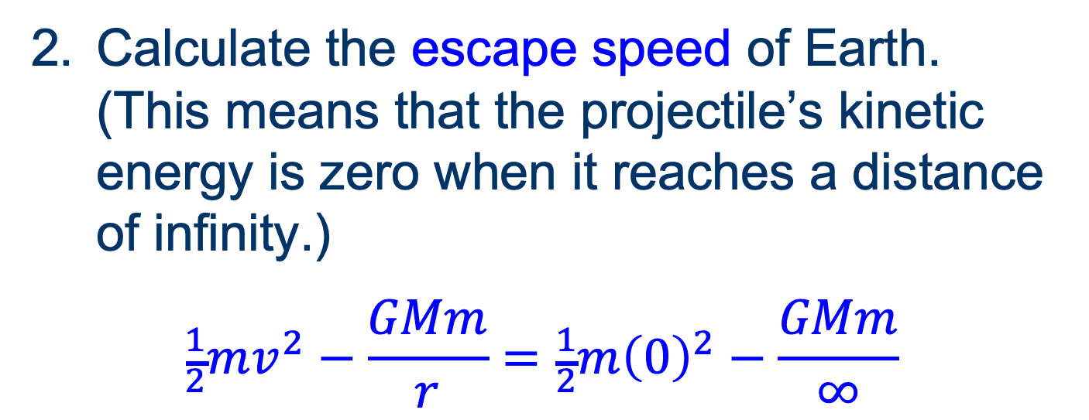
Example Problem
Calculate the escape speed of Earth. (This means that the projectile’s kinetic energy is zero when it reaches a distance of infinity.)
$$\frac{1}{2}mv^{2}−\frac{GMm}{r}=\frac{1}{2}m{\left(0\right)}^{2}−\frac{GMm}{∞}$$
M_{earth} = 5.976 × 10²⁴ kg
R_{earth} = 6378 km
G = 6.67 × 10^{–11} Nm²/kg²

Slide 16
Orbits
Satellite orbits a much larger attractor
Conservation of Energy
Kinetic + potential = K + U is constant

Slide 17
Orbits
E > 0: Open
  hyperbola
E = 0: Escape speed
  parabola
E < 0: Closed
  ellipse

Slide 18
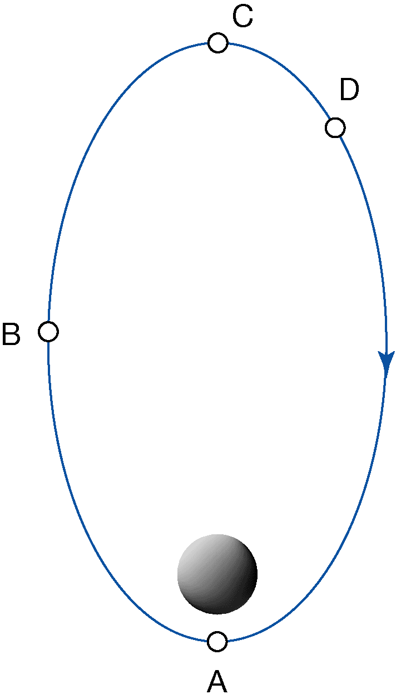
Poll Question
At which position is the satellite speeding up?
Position A.
Position B.
Position C.
Position D.
None of these.

Slide 19
Quick Question
At which position is the satellite slowing down?
Position A.
Position B.
Position C.
Position D.
None of these.

Slide 20
Poll Question
At which position is the satellite changing its direction but not its speed?
Position A.
Position B.
Position C.
Position D.
None of these.

Slide 21
Group Work
Rank the positions in descending order of:
  Gravitational force.
  Acceleration.
  Speed.
  Kinetic energy.
  Gravitational potential energy.
  Total energy.
  Angular momentum.

Slide 22
Closed Orbits
U_{g} + K_{tr} = constant < 0
The closer the satellite is to the main body, the faster it moves
Objects do not meet at rest without a non-conservative force acting

Slide 23
Example problems
Find the tangential speed v of an object in circular orbit a distance r from an attractor of mass M.
  Use the fact that the centripetal force is the force of gravity.
Find the orbital period T as well.
  Use the fact that v = 2πr/T.

Slide 24
Kepler’s Laws
of planetary motion
Planets travel in elliptical paths with one focus at the Sun.
In equal times, a planet’s path traces out equal areas.
The square of a planet’s orbital period is directly proportional to the cube of the semi-major axis of the orbit.

Slide 25
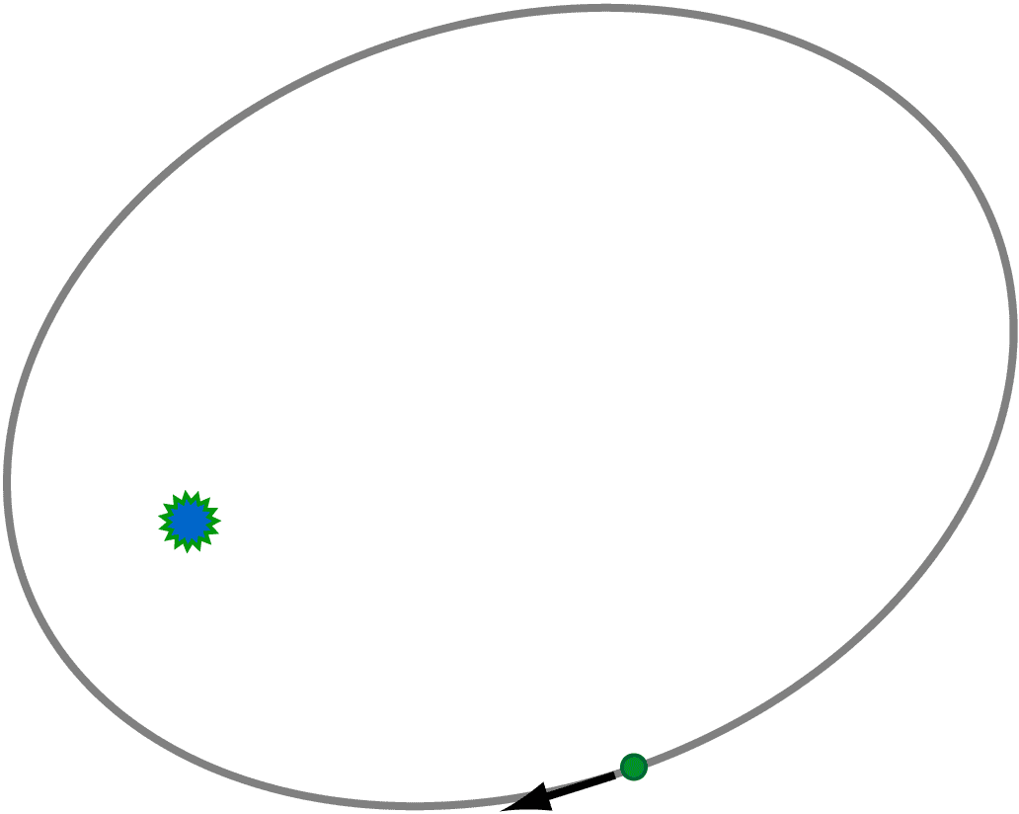
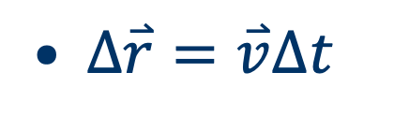
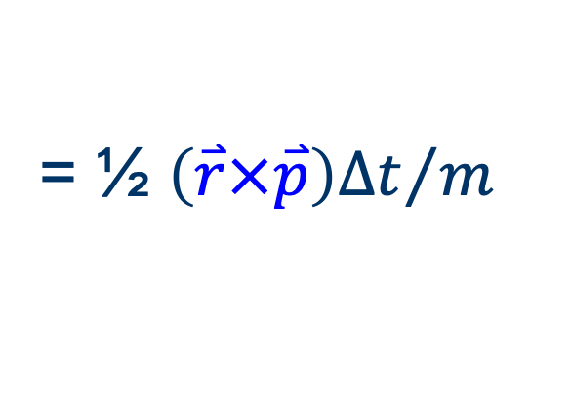


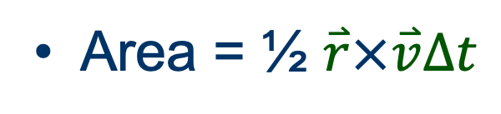
Equal Area Law (2)
Over a short ∆t, arc is linear
$∆\overset{⃑}{r}=\overset{⃑}{v}∆t$
Area = ½ of parallelogram
Area = ½ $\overset{⃑}{r}×\overset{⃑}{v}∆t$
= ½ ${\left(\overset{⃑}{r}×\overset{⃑}{p}\right)∆t}/m$
Angular momentum is conserved
$$\overset{⃑}{r}$$
$$∆\overset{⃑}{r}$$

Slide 26
Example Problem 12.51
Calculate the orbital distance of the Moon based on the observation that the Moon orbits the Earth once every 27.3 days. The mass of the Moon is 7.35 × 10²² kg and the mass of the Earth is 6.0×10²⁴ kg.

Slide 27
Example Problem
The planet Uranus has a radius of 25,362 km and a surface gravity of 8.87 N/kg at its poles. Its moon Miranda is in a circular orbit at a distance of 129,560 km from Uranus’s center. Miranda has a mass of 6.6 × 10¹⁹ kg and a radius of 235 km.
  Calculate the mass of Uranus from the given data.

Slide 28
Example Problem
The planet Uranus has a radius of 25,362 km and a surface gravity of 8.87 N/kg at its poles. Its moon Miranda is in a circular orbit at a distance of 129,560 km from Uranus’s center. Miranda has a mass of 6.6 × 10¹⁹ kg and a radius of 235 km.
  Calculate the magnitude of Miranda’s orbital acceleration due to its orbital motion about Uranus.

Slide 29
Example Problem
The planet Uranus has a radius of 25,362 km and a surface gravity of 8.87 N/kg at its poles. Its moon Miranda is in a circular orbit at a distance of 129,560 km from Uranus’s center. Miranda has a mass of 6.6 × 10¹⁹ kg and a radius of 235 km.
  Calculate the acceleration due to Miranda’s gravity at the surface of Miranda.

Slide 30
Example Problem
The planet Uranus has a radius of 25,362 km and a surface gravity of 8.87 N/kg at its poles. Its moon Miranda is in a circular orbit at a distance of 129,560 km from Uranus’s center. Miranda has a mass of 6.6 × 10¹⁹ kg and a radius of 235 km.
  Do the answers to parts b and c mean that an object released 1 m above Miranda’s surface on the side toward Uranus will fall up relative to Miranda? Explain what is happening.

