Slide 1
Collisions
basically include every interaction
§ 8.3–8.4

Slide 2
All Interactions
Interacting objects apply equal and opposite forces (and impulses) to each other
Total momentum is conserved

Slide 3
Elastic Collisions
Objects bounce apart after collision
Kinetic energy is conserved
Relative speed is also conserved
Some momentum is transferred from one object to another

Slide 4
Totally Inelastic Collisions
Objects cling together after collision
Same final velocity
Total momentum is maintained in the coupled mass (momentum is conserved)

Slide 5
Inelastic Collisions
Kinetic energy is not conserved
Momentum is nonetheless conserved

Slide 6
Group work
Initial conditions m₁, v₁, m₂, v₂
What is final velocity v_{f} of a totally inelastic collision?

Slide 7

Group work
Two cars of equal mass are traveling opposite directions at speed v. They collide completely inelastically and stick together. What is the final speed of the combined mass?
Notes:
final v = 0

Slide 8
Group work
Two cars of equal mass are traveling opposite directions at speed v. They collide completely elastically. What is the final velocity of the car on the left?
Notes:
final v = –v for the car on the left, +v for the car on the right

Slide 9

Group work
A car of mass M traveling to the left collides with a car of mass M initially stationary but free to move. The collide totally inelastically and stick together. What is the final velocity of the combined vehicles?
Notes:
total p = –MV
final v = p/(2M) = –MV/(2M) = –V/2

Slide 10

Group work
Two cars of unequal mass travel at different speeds in opposite directions as indicated. They collide totally inelastically and stick together. What is the final velocity of the vehicle on the left?
Notes:
Total p = MV + (2M)(–2V) = MV – 4MV = –3MV
final v = p/(3M) = (–3MV)/(3M) = –V

Slide 11
Example Problem
A car of mass M traveling to the left collides with a car of mass M initially stationary but free to move. The collide completely elastically. What is the final velocity of the initially stationary car?

Slide 12
Elastic collision
2 unknowns
  v_{1f}
  v_{2f}
2 equations:
  conservation of energy
  conservation of momentum

Slide 13
Elastic collision
m₁v_{1i} + m₂v_{2i} = m₁v_{1f} + m₂v_{2f}
½ m₁v_{1i}² + ½ m₁v_{1i}² = ½ m₁v_{1i}² + ½ m₁v_{1i}²

Slide 14
Elastic collision
m₁ – m₂
2m₂
v_{1f} = v_{1i}
+ v_{2i}
m₁ + m₂
m₁ + m₂
m₂ – m₁
2m₁
v_{2f} = v_{2i}
+ v_{1i}
m₁ + m₂
m₁ + m₂

Slide 15
Inelastic Collision
2 unknowns, but what equations do we have?
  conservation of momentum
  ?
We need more information
  e.g. one of the final velocities

Slide 16
Example Problem
Two asteroids of equal mass collide with a glancing blow. Asteroid A, which was initially traveling at 40.0 m/s, is deflected 30.0° from its original direction, while asteroid B, which was initially at rest, travels at 45.0° to the original direction of A.
A
30°
A
B
45°
Find the speed of each asteroid after the collision.
What kind of collision is this?
What fraction of the original kinetic energy of asteroid A dissipates during the collision?

Slide 17
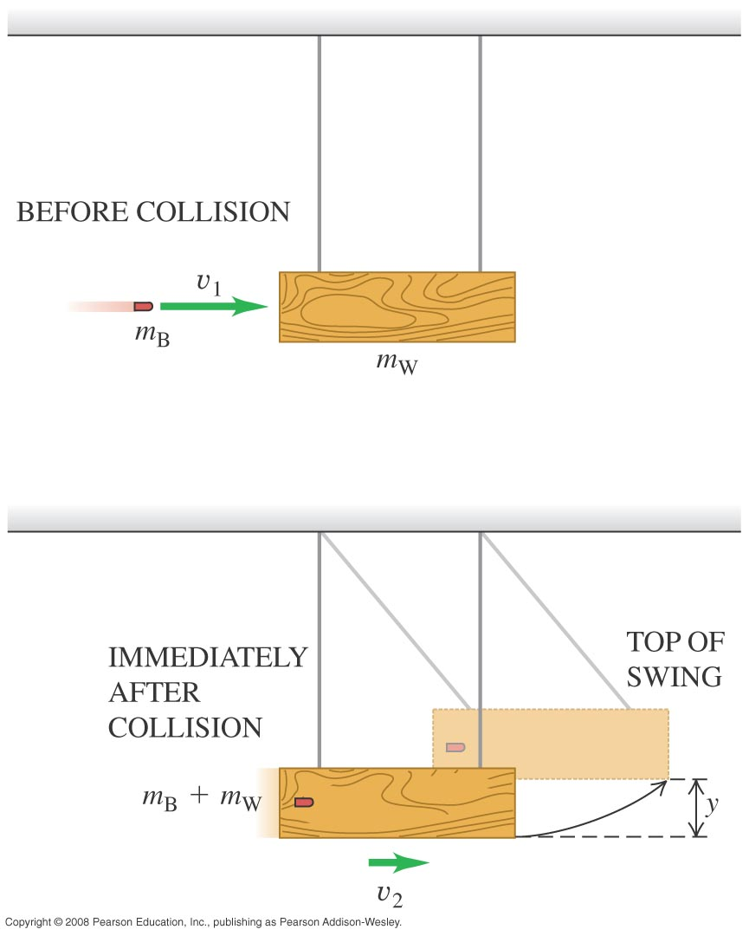
Example Problem
A 12.0-g rifle bullet is fired with a speed of 380 m/s into a wood block pendulum with mass 6.00 kg, suspended from two cords 70.0 cm long. The bullet embeds in the block, and the block swings upward after impact.
What kind of collision is this?
Compute the kinetic energy of the bullet and pendulum immediately after the bullet becomes embedded in the pendulum.

Slide 18
Example Problem
A 12.0-g rifle bullet is fired with a speed of 380 m/s into a wood block pendulum with mass 6.00 kg, suspended from two cords 70.0 cm long. The bullet embeds in the block, and the block swings upward after impact.
Compute the vertical height through which the pendulum rises.
What fraction of the initial kinetic energy of the system was lost in the collision?

Slide 19
Coefficient of Restitution
||final velocity difference||
e =
||initial velocity difference||
Elastic collision: e = 1
Totally inelastic collision: e = 0
Inelastic collision: 0 < e < 1

Slide 20
Center of Mass
when sets act like single particles
§ 8.5

Slide 21
Center of Mass
Location of center of mass:
weighted average of particle positions
r_{cm} = Σm_{i}r_{i}/Σm_{i}

Slide 22
Center of Mass
Velocity of center of mass:
Time-derivative of position
v_{cm} = d/dt (Σm_{i}r_{i}/Σm_{i})
= Σm_{i}v_{i}/Σm_{i}
= p_{tot}/m_{tot}

Slide 23

Poll Question
Two joined cars of mass M and 2M are at rest with a compressed spring between them. After the spring fires, one car moves off to the right and the other to the left. The speed of the car on the left is
Zero.
equal to the one on the right.
one half the speed on the right.
twice the one on the right.
warp nine.

Slide 24
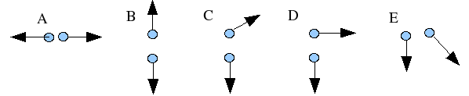
Poll Question
A firework shell is launched vertically into the air and at the top of its trajectory an explosive charge breaks the shell into two pieces. In which directions is it possible for the two pieces to move? The pieces do not necessarily have equal mass and the arrow indicate only the direction of the velocity, not the speed.
A only
A or B
A, B, or C
A,B,C, or D
All of the above are possible
None of the above are possible

Slide 25
Example Problem 8.97
A fireworks rocket is fired vertically upward. At its maximum height of 80 m it explodes and breaks into two pieces of mass 1.4 kg and 0.28 kg. In the explosion, 860 J of chemical energy is released and converted into kinetic energy of the fragments.
What is the speed of each fragment?
If they hit the ground at the same time, what is the distance between them?

Slide 26
CM Reference Frame
It is often convenient to analyze interactions in the reference frame with its origin at the center of mass.
Total momentum is zero
Particle momentums equal and opposite
Speeds inversely proportional to masses
Speeds same before and after elastic collisions

Slide 27
Continuous object
Integrate over area
$${\overset{⃑}{r}}_{\text{cm}}={\iint_{A}{\overset{⃑}{r}dm}}/{\iint_{A}{dm}}$$
or volume
$${\overset{⃑}{r}}_{\text{cm}}={\iiint_{V}{\overset{⃑}{r}dm}}/{\iiint_{V}{dm}}$$

