Slide 1
Angular Momentum
is conserved
§ 10.5–10.6

Slide 2
Angular Momentum
Torque is rotational force
Angular momentum is rotational momentum
L = r × p
Angular momentum is a vector
Direction by right-hand rule

Slide 3
Linear-Angular Correspondence
τ = Iα
L = Iω
F = ma
p = mv
Angular quantities are defined with respect to a reference point

Slide 4
Question
Two wheels in contact rotate with the same tangential speed at their rims. Wheel A has half the radius of the wheel B.
Which has the greater centripetal acceleration?
A particle at the rim of A.
A particle at the rim of B.
Both have the same centripetal acceleration.
Cannot be determined.
A
B

Slide 5
Question
Two wheels in contact rotate with the same tangential speed at their rims. Wheel A has half the radius of the wheel B.
Which has the greater angular momentum about its axis of rotation?
A particle at the rim of A.
A particle at the rim of B.
Both have the same angular momentum.
Cannot be determined.
A
B

Slide 6
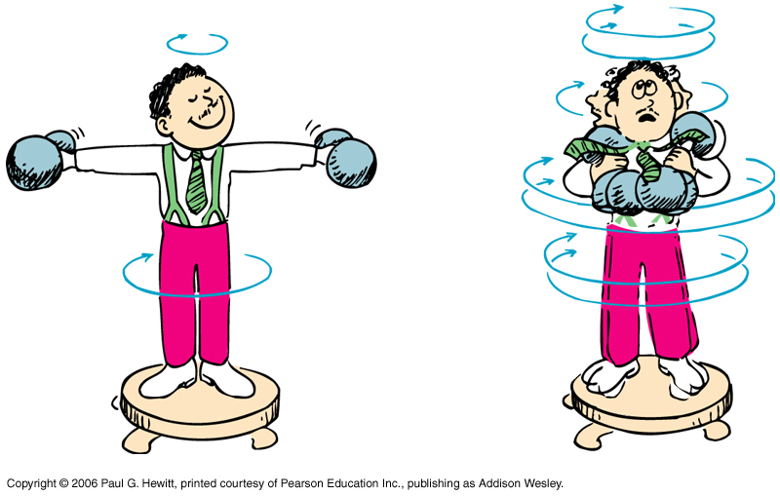
Conservation of Angular Momentum
If no outside torque, L = r × p is constant.
If r decreases, p increases!

Slide 7
Conservation of Angular Momentum
Nothing can apply a torque to itself.
Any change in one object’s angular momentum is accompanied by an opposite change in another object. (About the same reference point.)
The angular momentum of the universe never changes.

Slide 8
Conservation of Momentum
Q. How can linear momentum be conserved if p increases?
A. Total linear momentum is zero in a rotating system!

Slide 9
Conservation of Energy
Q. What happens to kinetic energy when p increases?
A. Kinetic energy increases! ΔE = W.
Work is done to pull rotating parts inward.

Slide 10
Discussion: Ballistic Pendulum
θ
R
v
m
M, I
Find ω in terms of m, M, R, I, v
Find maximum θ

Slide 11
Discussion: Ballistic Pendulum
How can we find I of the catcher?
When can we neglect I_{cm} of the ball?
How can we find v from θ?
Why is angular momentum but not linear momentum conserved?
Notes:
11

Slide 12
Balanced Rotation
Ring rotating in-plane about its center
Viewed from its center
All points have same L ↑

Slide 13
Balanced Rotation
Ring rotating in-plane about its center
Viewed from below its center
All points have different L’s
Total L is ↑

Slide 14
Balanced Rotation
Ring rotating in-plane about its center
Viewed from an arbitrary point
All points have different L’s
Total L is ↑

Slide 15
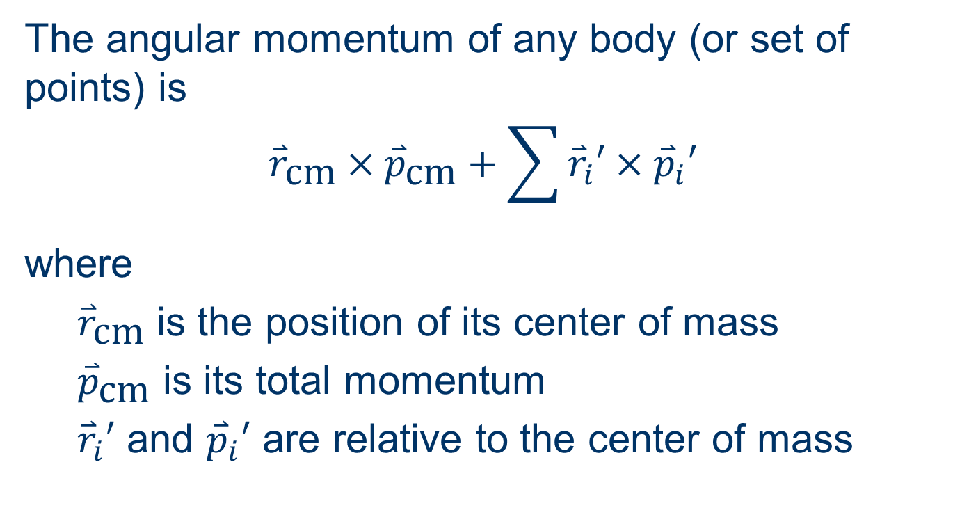
Angular Momentum Partition Theorem

Slide 16
Unbalanced Rotation
Rod rotating off-axis about its center
Viewed from its center
L
F
L
F
Rotating net torque needed (now •)
L constantly rotates
Time-averaged L is ↑

Slide 17
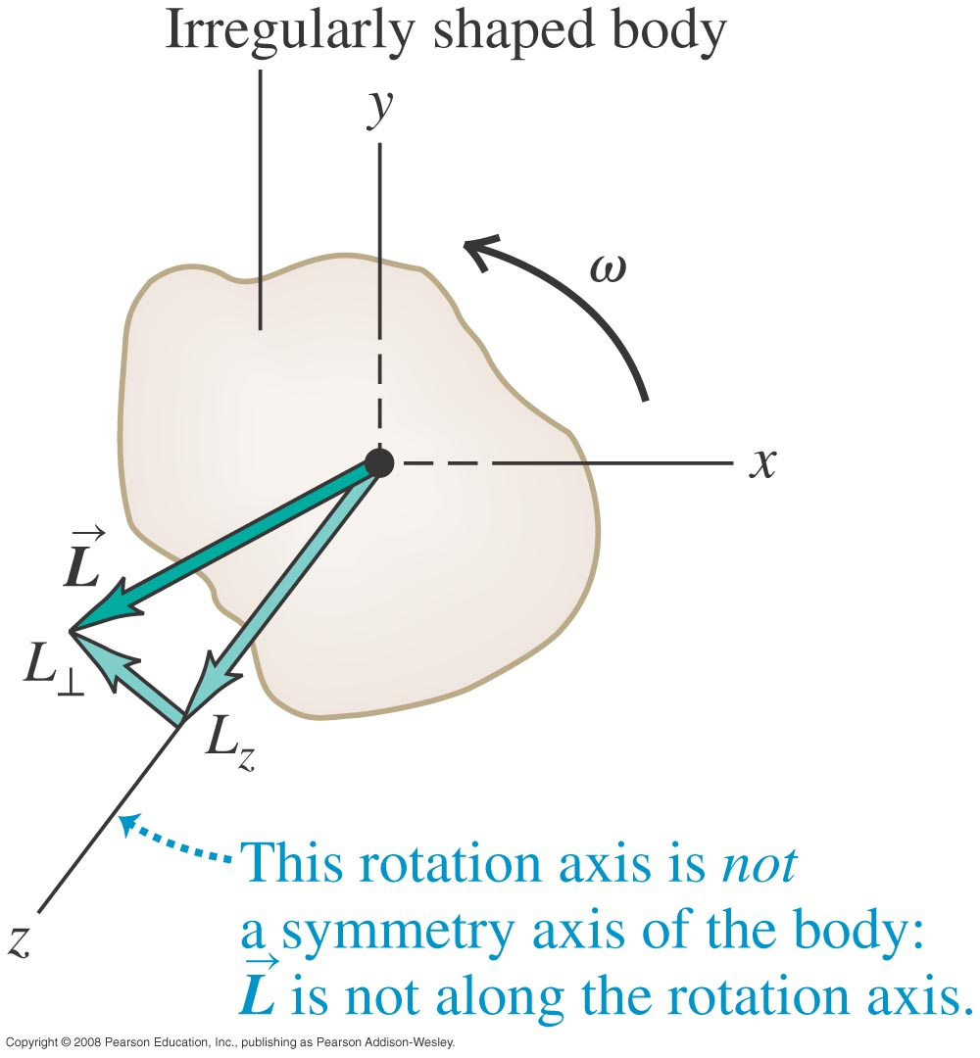
Note on book
Figure 10.27 caption:
States ω is constant.
That depends on the definition of ω.
For L = Iω, the direction of ω rotates.

