Slide 1
Wave Mechanics
speed, work, energy, etc.
§ 15.4–15.5

Slide 2
Wave Speed
textbook’s second derivation
§ 15.4
Notes:
2

Slide 3
Transverse String Wave Speed
Tension F_{x}
Length density μ = m/L
Mass of differential element = ∂m = μ∂x
Acceleration = ∑F_{y} /m
F₂
F₁
F
∂y₂
F_{y}
∂y₁
∂x
F_{x}
∂x
F_{y} = F_{x} ∂y/∂x

Slide 4
Wave Energy Transfer
energy flows
§ 15.5
Notes:
4

Slide 5
Energy in a Traveling Wave
y = A cos(kx – ωt)

Slide 6
Power
y(x,t) = A cos(kx – ωt)
Rate of doing work on element ahead
P = F_{y}v_{y}
propagation direction
F_{x}
v_{y}
F_{y}
F_{y} = –F_{x} ∂y/∂x = +F_{x} Ak sin(kx – ωt)
v_{y} = ∂y/∂t = +Aω sin(kx – ωt)
P = F_{x} A²kω sin²(kx – ωt)

Slide 7
t = 0

Slide 8
t = T/8

Slide 9
t = T/4

Slide 10
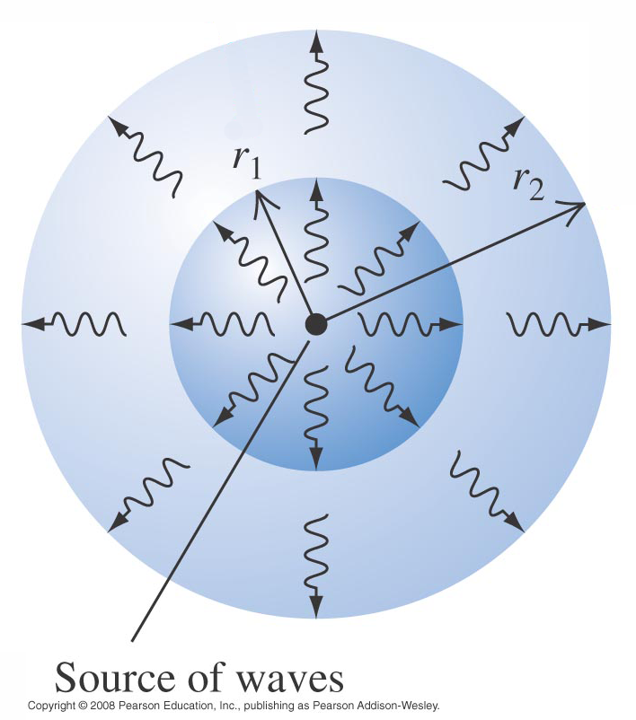
Wave Intensity
Energy transfer per time per area
Units: W/m²
Decreases with distance
  inverse square in 3-D
P
I =
4πr²
  different in 1 and 2 dimensions

