Slide 1
Temperature
Related to energy
§17.1–4

Slide 2
Heat
Energy transferred because of a temperature difference
high T
heat
low T
Q
Zero heat flow at thermal equilibrium

Slide 3

Thermal Equilibrium
A
B
Insulation
At equilibrium T_{A} = T_{B}
“0th Law of Thermodynamics”

Slide 4
Thermodynamic Definition
Temperature is the quantity that is the same for bodies in thermal equilibrium.

Slide 5
Temperature Scales
We could measure it before we knew what it was
§ 17.2

Slide 6
Fahrenheit Scale
0 °F: salt-ice slush
100 °F: body temperature

Slide 7
Celsius Scale
0 °C: water freezes
100 °C: water boils

Slide 8
Converting
Linear relation, 2 points known
(0 °C, 32 °F), (100 °C, 212 °F)
5 °C
°F→°C: x =
(y – 32 °F)
9 °F
9 °F
°C→°F: y =
x + 32 °F
5 °C

Slide 9
Question
There is a temperature at which the readings in °C and °F are the same.
True.
False.

Slide 10
Kelvin Scale
Absolute temperature
§ 17.3

Slide 11
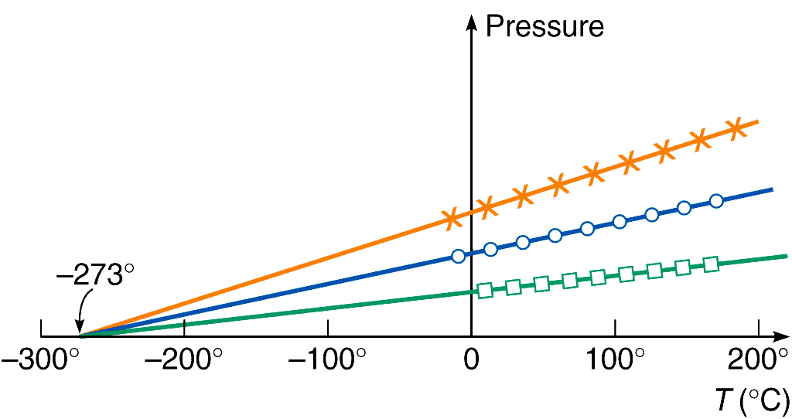
Temperature and Gas Pressure
(constant volume)
different samples
Absolute zero
Source: Griffith, Physics of Everyday Phenomena, Fig. 10.6

Slide 12
Absolute Zero
Gas p decreases with T
Absolute zero ≡ T at which p = 0
Minimum total molecular kinetic energy

Slide 13
Kelvin scale
Unit: K
K = same size as °C
but
0 K = absolute zero
(T in K) = 273.15 + (T in °C)

Slide 14
Question
How do the temperatures 273.15 °C and 273.15 K compare?
273.15 °C is the same as 273.15 K.
273.15 °C is half 273.15 K.
273.15 °C is twice 273.15 K.
273.15 °C is absolute zero.

Slide 15
Thermal Expansion
§ 17.4

Slide 16
Linear Expansion
L₀
T₀
L₀ + ΔL
T₀ + ΔT
ΔL
= α ΔT
L₀
α = coefficient of linear expansion
~constant for small ΔT

Slide 17
Some α values
Aluminum 2.4×10^{–5} /K
Brass 2.0×10^{–5} /K
Copper 1.7×10^{–5} /K
Steel 1.2×10^{–5} /K
Glass 0.4–0.9×10^{–5} /K
Quartz 0.04×10^{–5} /K
HDPE 10–20×10^{–5} /K
Wood 0.3, 3.0×10^{–5} /K

Slide 18
Question
A metal ring is heated. What happens to its outer diameter?
It increases.
It stays the same.
It decreases.
Impossible to determine.

Slide 19
Question
A metal ring is heated. What happens to its inner diameter?
It increases.
It stays the same.
It decreases.
Impossible to determine.

Slide 20
Volume Expansion
V₀ + ΔV
T₀ + ΔT
V₀
T₀
ΔV
= β dT
V₀
If expansion is isotropic,
and ΔT is small,
β = 3α

Slide 21
Some β values
ethanol 1.40 × 10^{–3} /K
methanol 1.49 × 10^{–3} /K
gasoline 1.1 × 10^{–3} /K
water varies with temperature

Slide 22
V₀ = L_{0x} L_{0y} L_{0z}
V = V₀ + dV = (L_{0x} + L_{0x}αΔT) (L_{0y} + L_{0y}αΔT) (L_{0z} + L_{0z}αΔT)
= L_{0x} L_{0y} L_{0z} (1 + αΔT)³
= V₀ (1 + αΔT)³
ΔV = V – V₀ = V₀ (1 + αΔT)³ – V₀
ΔV/V₀ = (1 + αΔT)³ – 1
ΔV/V₀ = 1 + 3αΔT + 3α²ΔT² + α³ΔT³ – 1
ΔV/V₀ ≈ 3αΔT when α and ΔT are small
Q.E.D.

Slide 23
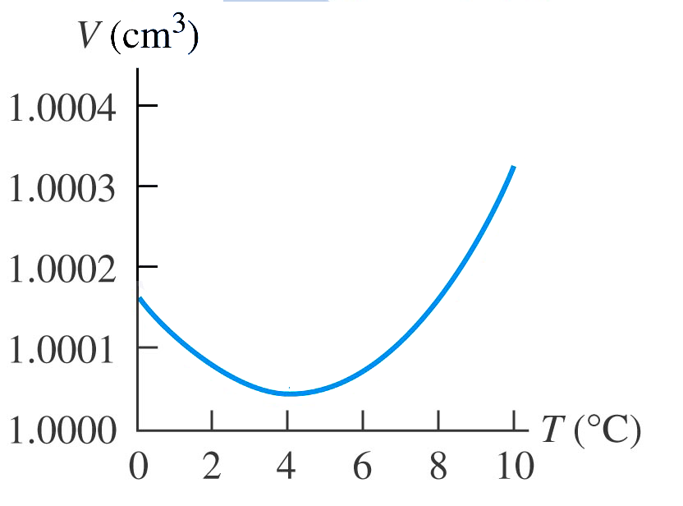
Water is Weird
Source: Young and Freedman, Figure 17.12
Density maximum disappears above ~2.5% salt

Slide 24
Question
Between 0°C and 4°C, warmer fresh water
Rises above colder water.
Sinks beneath colder water.
Has neutral buoyancy.
It is impossible to determine.

Slide 25
Thermal Stress
Results from:
Uneven composition
Uneven temperature
Exacerbated by large expansion coefficient

