Slide 1
Error Propagation
Calculations using measurements

Slide 2
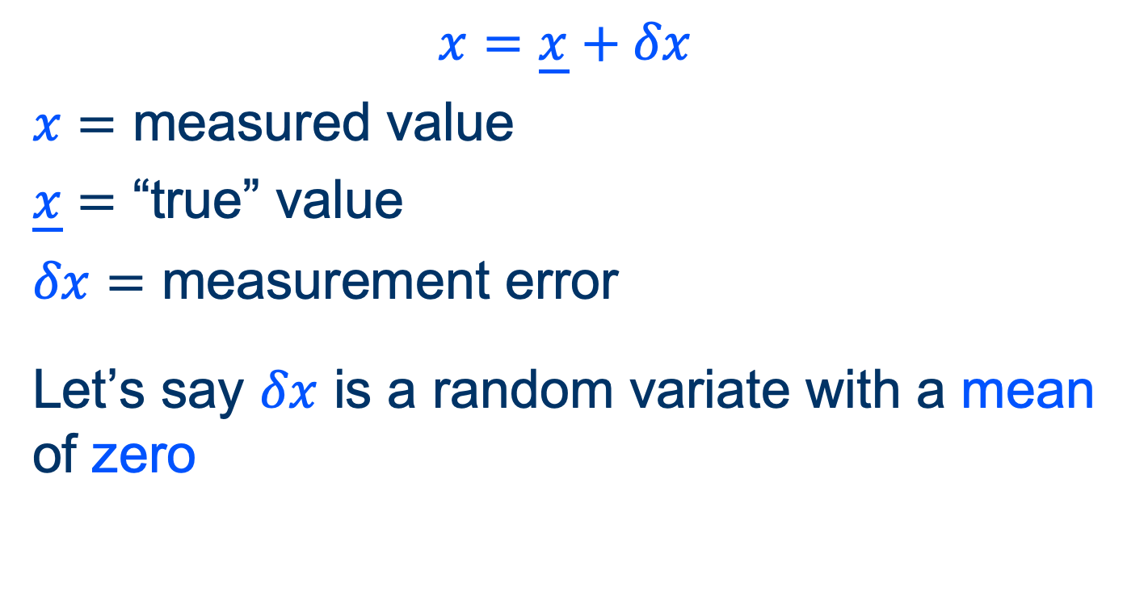
Taking a measurement
$$x=\underline{x}+δx$$
$x=$ measured value
$\underline{x}=$ “true” value
$δx=$ measurement error
Let’s say $δx$ is a random variate with a mean of zero

Slide 3
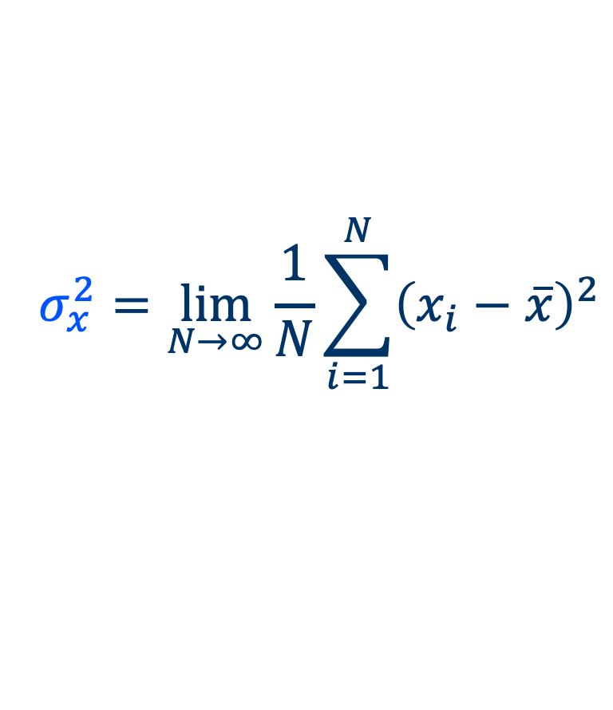
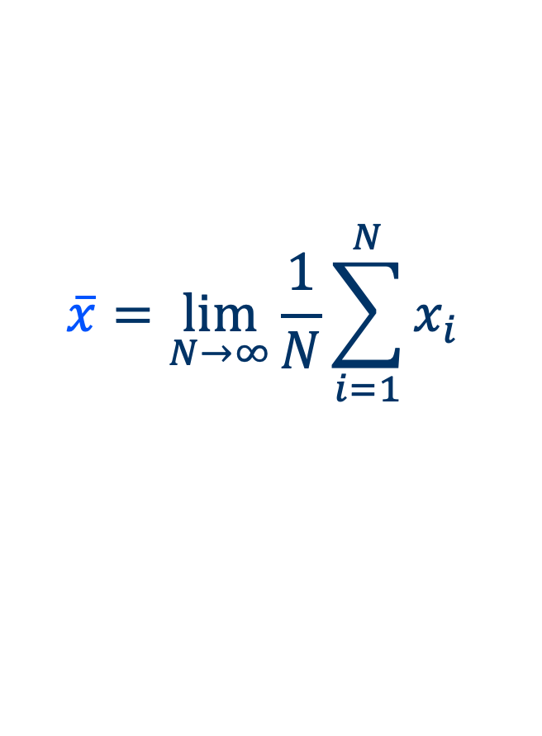
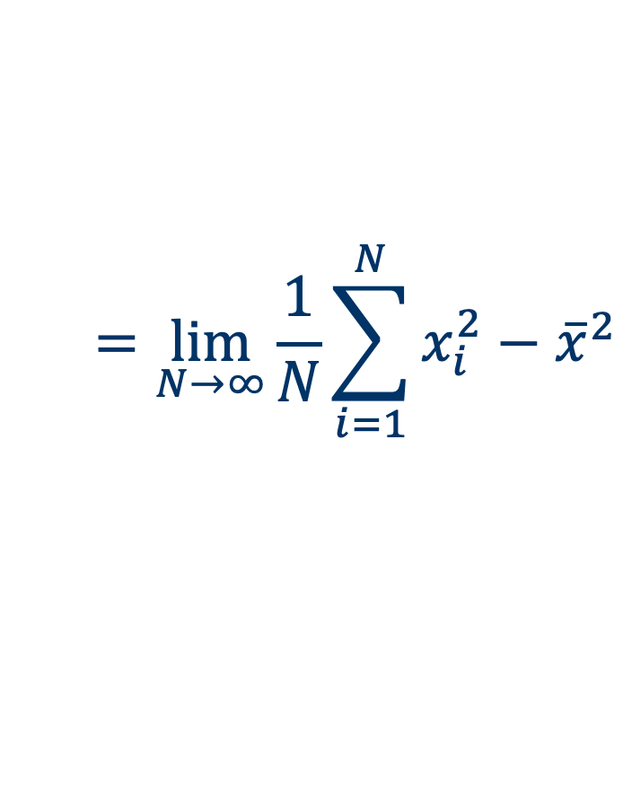
Characterizing random variates
$$\overline{x}=\lim_{N→∞}{\frac{1}{N}\sum_{i=1}^{N}{x_{i}}}$$
Mean
$$σ_{x}^{2}=\lim_{N→∞}{\frac{1}{N}\sum_{i=1}^{N}{{\left(x_{i}−\overline{x}\right)}^{2}}}$$
Variance
$$=\lim_{N→∞}{\frac{1}{N}\sum_{i=1}^{N}{x_{i}^{2}−{\overline{x}}^{2}}}$$

Slide 4
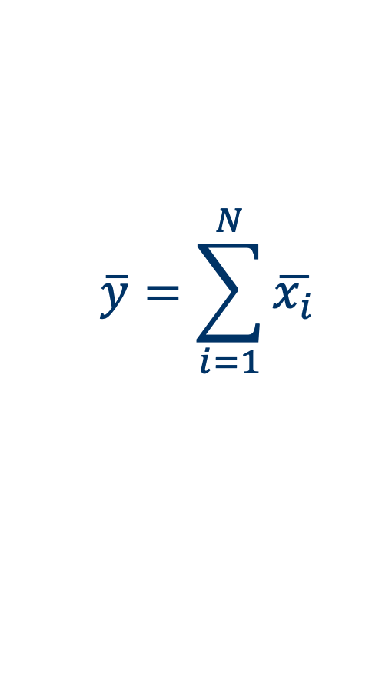
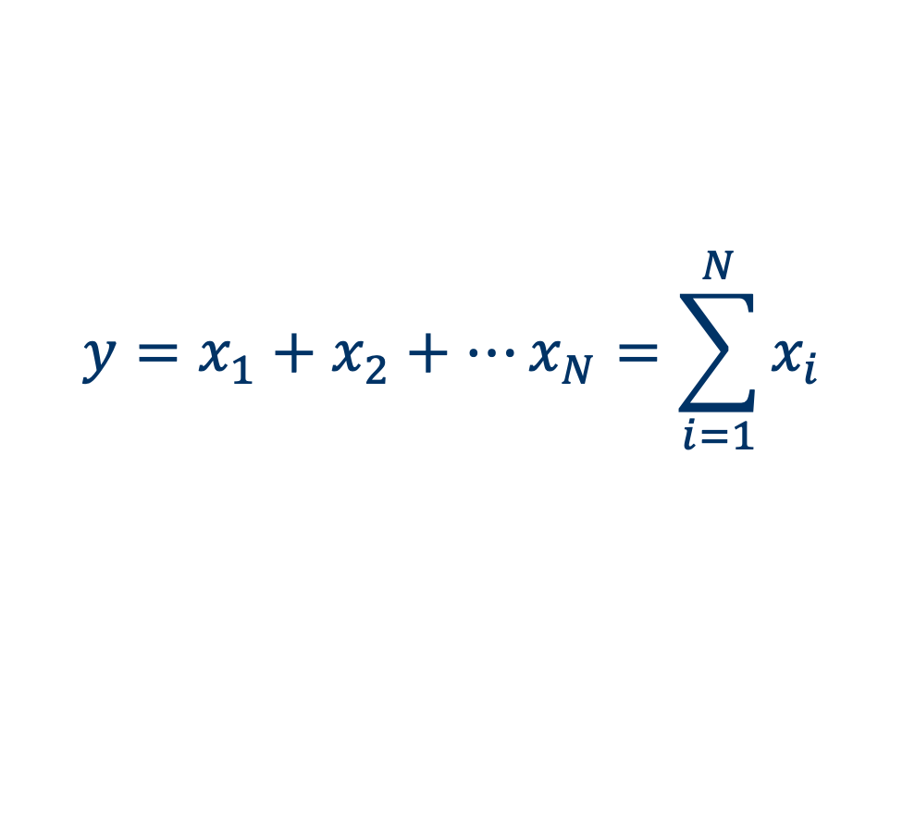
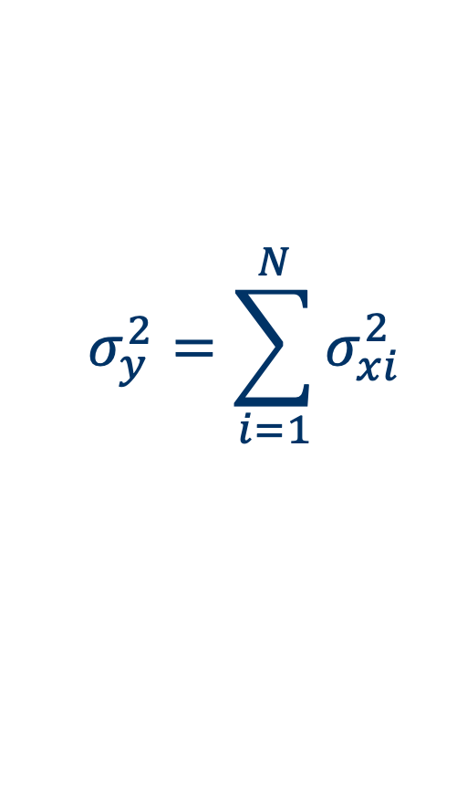
Sums of random variates
$$y=x_{1}+x_{2}+⋯x_{N}=\sum_{i=1}^{N}{x_{i}}$$
$$\overline{y}=\sum_{i=1}^{N}{\overline{x_{i}}}$$
Mean
Means add
$$σ_{y}^{2}=\sum_{i=1}^{N}{σ_{xi}^{2}}$$
Variance
Variances add

Slide 5
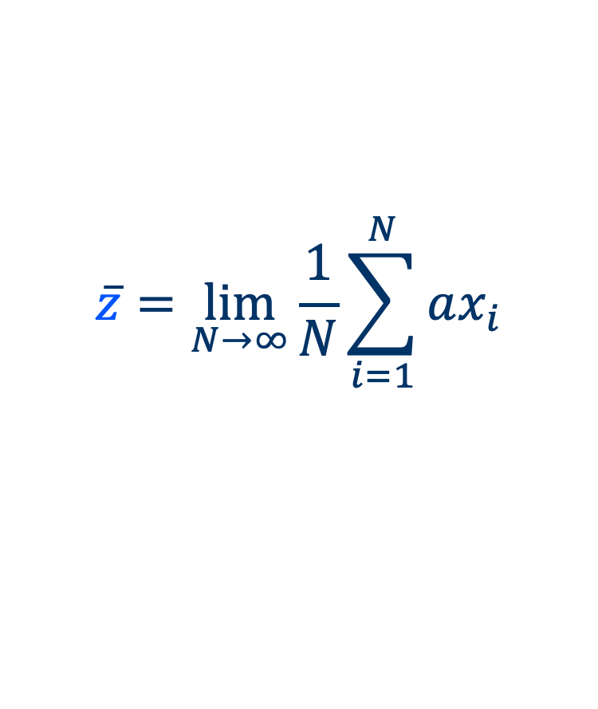
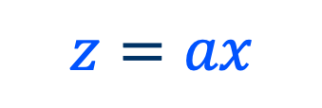
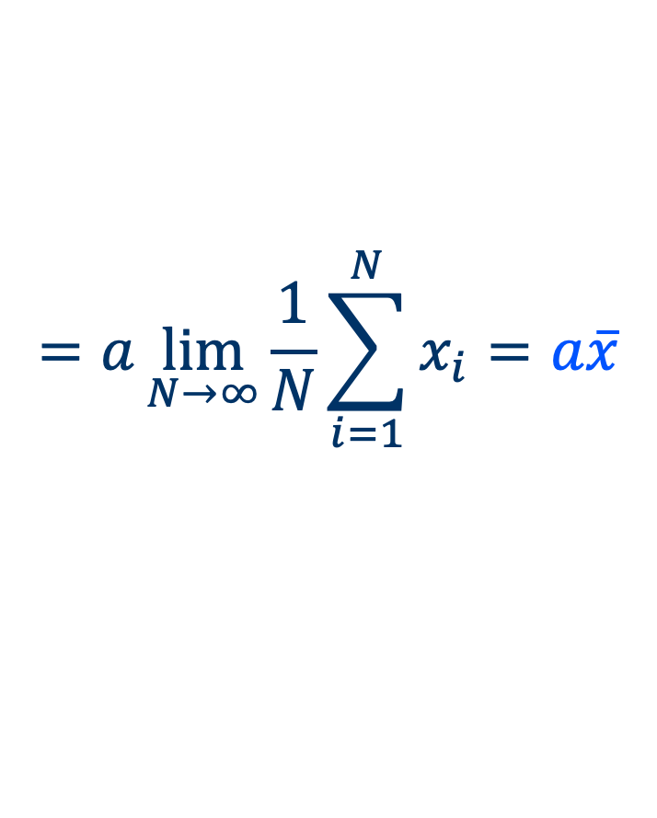
Multiple of a variate
$$z=ax$$
$$\overline{z}=\lim_{N→∞}{\frac{1}{N}\sum_{i=1}^{N}{ax_{i}}}$$
Mean
$$=a\lim_{N→∞}{\frac{1}{N}\sum_{i=1}^{N}{x_{i}}=a\overline{x}}$$

Slide 6
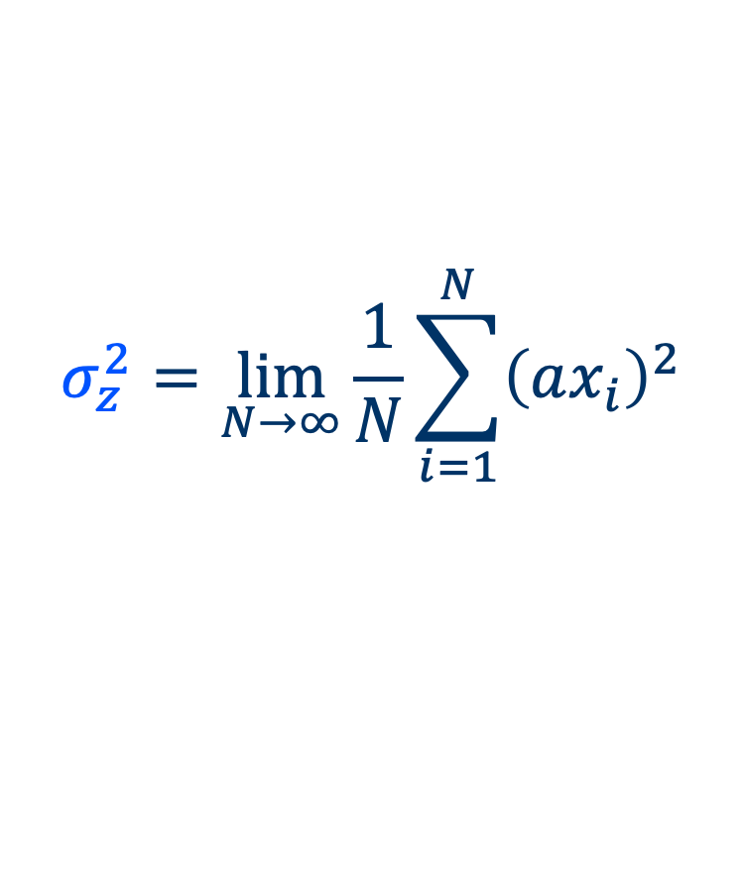
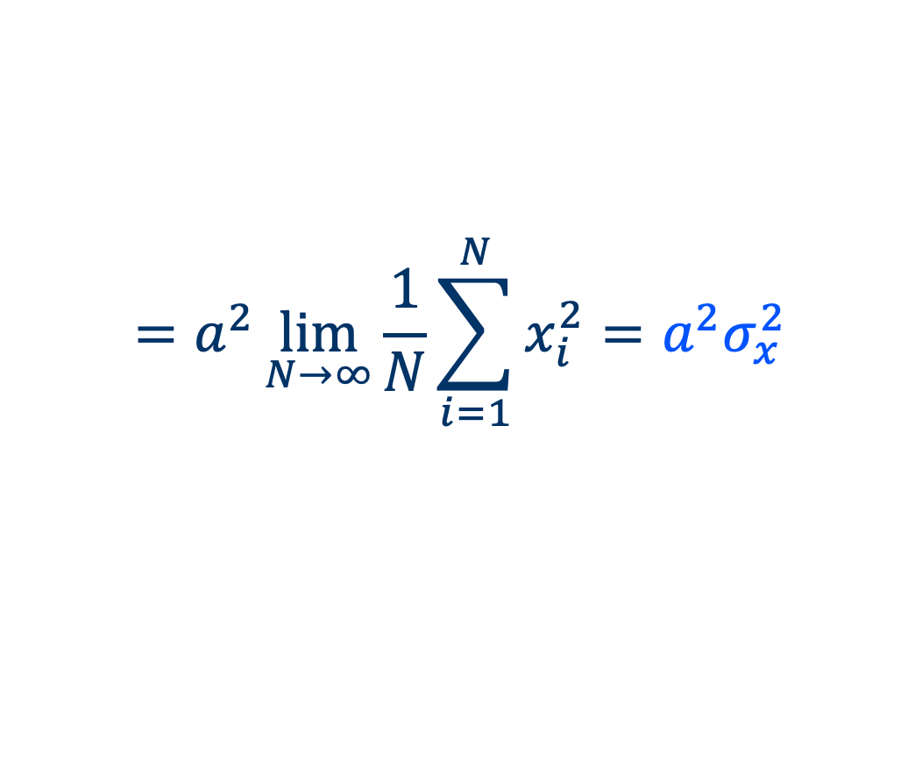
Multiple of a variate
$$z=ax$$
$$σ_{z}^{2}=\lim_{N→∞}{\frac{1}{N}\sum_{i=1}^{N}{{\left(ax_{i}\right)}^{2}}}$$
Variance
$$=a^{2}\lim_{N→∞}{\frac{1}{N}\sum_{i=1}^{N}{x_{i}^{2}}=a^{2}σ_{x}^{2}}$$

Slide 7
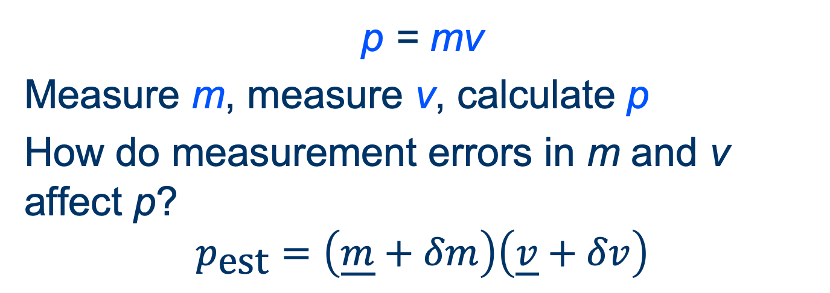

Example: Momentum
p = mv
Measure m, measure v, calculate p
How do measurement errors in m and v affect p?
$$p_{\text{est}}=\left(\underline{m}+δm\right)\left(\underline{v}+δv\right)$$
$$p_{\text{est}}=\underline{m}\underline{v}+\underline{m}δv+\underline{v}δm+δmδv$$
$$p_{\text{est}}=\underline{p}+\underline{m}δv+\underline{v}δm=\underline{p}+δp$$

Slide 8
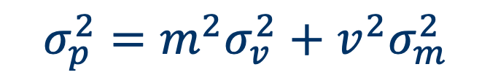

Example: Momentum
How do measurement errors in m and v affect p?
$$δp=\underline{m}δv+\underline{v}δm$$
$$σ_{p}^{2}=m^{2}σ_{v}^{2}+v^{2}σ_{m}^{2}$$

Slide 9
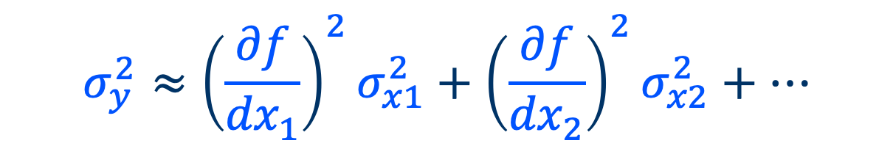
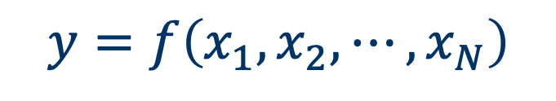

General: Linear Approximation
If
$$y=f\left(x_{1},x_{2},⋯,x_{N}\right)$$
then
$$y_{\text{est}}=\underline{y}+δy≈\underline{y}+\left(\frac{∂f}{dx_{1}}\right)δx_{1}+⋯$$
$$σ_{y}^{2}≈{\left(\frac{∂f}{{dx}_{1}}\right)}^{2}σ_{x1}^{2}+{\left(\frac{∂f}{{dx}_{2}}\right)}^{2}σ_{x2}^{2}+⋯$$

