Slide 1
Gas Behavior
formulas from models
§ 19.6

Slide 2
The Mole
SI Unit of quantity

Slide 3
Avogadro’s Number N_{A}
Number of particles in a mole
N_{A} = 6.022×10²³ /mol

Slide 4
Ideal Gas Equation of State
“Ideal” means “oversimplified”
§ 18.3

Slide 5
Ideal Gas Model
molecules: non-interacting point masses
collide elastically with surfaces
Temperature T is related to kinetic energy K
K_{tr} = 1/2 kT per mode of motion
k = 1.3806505 × 10^{–23} J/K
(Boltzmann constant)

Slide 6
Question
What determines the pressure of a sample of a gas? Increasing the volume:
A. Has no effect
B. Increases the pressure
C. Decreases the pressure

Slide 7
Question
What determines the pressure of a sample of a gas? Increasing the number of molecules:
A. Has no effect
B. Increases the pressure
C. Decreases the pressure

Slide 8
Question
What determines the pressure of a sample of a gas? Increasing the temperature:
A. Has no effect
B. Increases the pressure
C. Decreases the pressure

Slide 9
Ideal Gas EOS
What is the pressure?
L_{y}
L_{z}
L_{x}

Slide 10
Ideal Gas EOS
P = F/A
F = Δp/Δt
Δp = impulse on wall per collision = 2mv_{x}
Δt = average time between collisions of one molecule with the wall = 2L_{x}/v_{x}
If there are N molecules, Δt = 2L_{x}/(Nv_{x})
A = area of wall = L_{y}L_{z}
½ mv_{x}² = ½ kT
mv_{x}² = kT
Notes:
Capital P is pressure; lowercase p is momentum (sorry!)

Slide 11
Ideal Gas EOS
P = F/A
Nv_{x}
2mv_{x}
2L_{x}
P =
L_{y}L_{z}
Nmv_{x}²
=
L_{x}L_{y}L_{z}
= NkT/V = nRT/V
R = N_{A}k

Slide 12
Ideal Gas Model
shows expansion with increasing T at constant P
shows P increase with increasing T at constant V
shows P = 0 at T = 0 K

Slide 13
RMS Speed
1/2 mv_{x}² = 1/2 kT
mv_{x}² = kT
v² = v_{x}² + v_{y}² + v_{z}²
v² = 3v_{x}²
mv² = 3mv_{x}² = 3kT
v² = 3kT/m
v =
3kT/m
=
3RT/M
m = molecular mass
M = molar mass = N_{A}m

Slide 14
Question
At constant temperature, how are pressure and volume of an ideal gas related?
They are directly proportional.
They are negatively correlated.
They are inversely proportional.
They are unrelated.

Slide 15
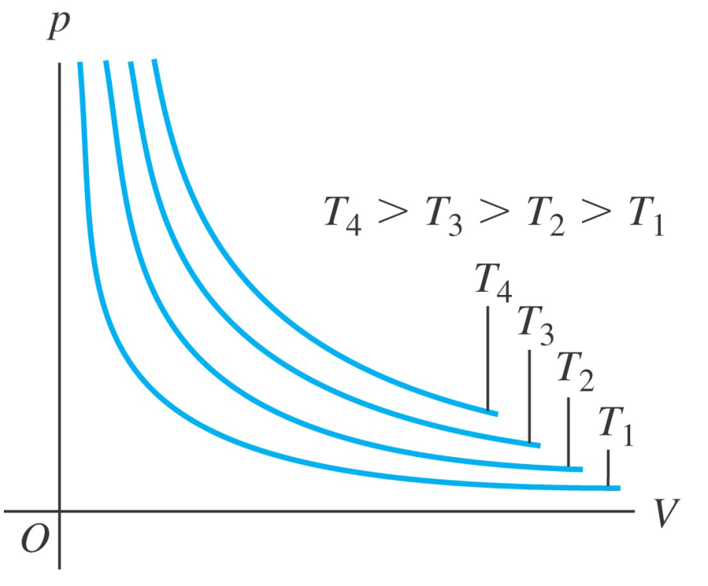
Ideal gas p-V plot
Ideal gas
Source: Y&F, Figure 18.6

Slide 16
Boyle’s Law
Ideal gas at constant temperature
P₁V₁ = P₂V₂
Pressure and volume inversely related

Slide 17
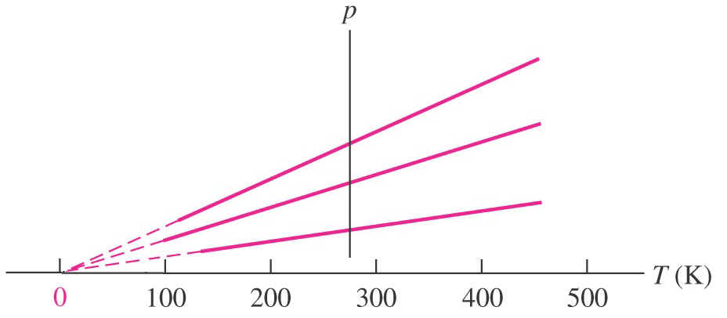
V-T plots
Gas
V
P₁
P₂
P₃
Source: Y&F, Figure 17.5b

Slide 18
p-T plots
Gas
Source: Y&F, Figure 17.5b

Slide 19
Deviations from Ideality
The Ideal EOS doesn’t explain
§ 14.4

Slide 20
Ideal Gas Model
Does not address interaction behavior
condensation
mean-free path
sound transmission
slow diffusion

Slide 21
van der Waals EOS
Molecules have volume
Molecules attract (dimerize)
nRT
an²
p =
–
V – nb
V ²

Slide 22
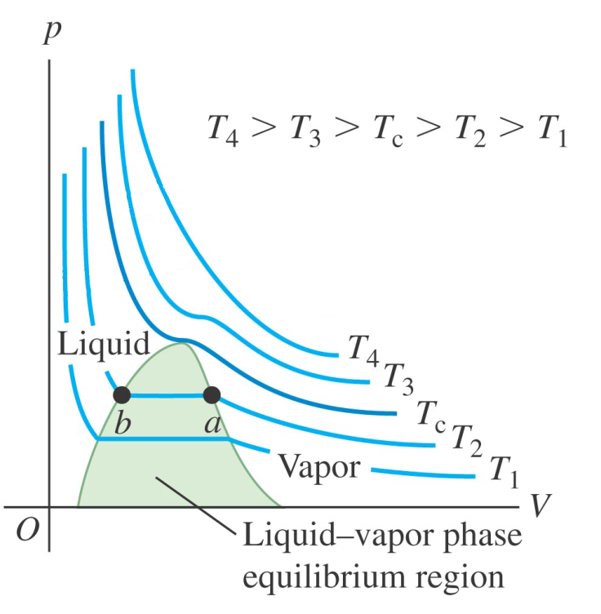
p-V plots
Ideal gas
Real Substance
Source: Y&F, Figure 18.6
Source: Y&F, Figure 18.7

Slide 23
Mean Free Path
V
λ =
4π 2 r² N
kT
=
4π 2 r² p
r = molecular radius

