Slide 1
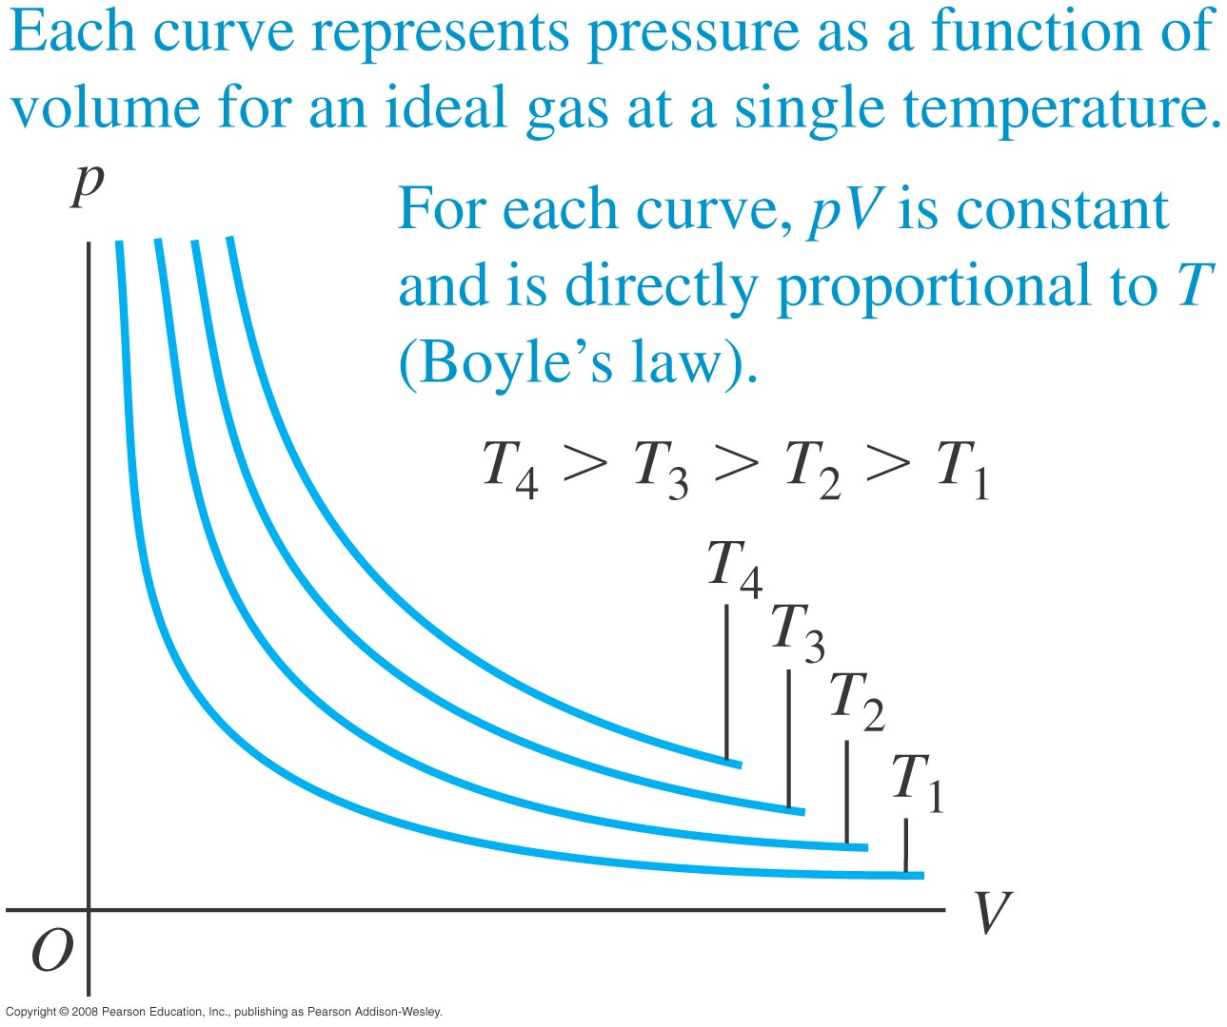
PV Plot for Ideal Gas
Isotherms

Slide 2
Specific Heats of Ideal Gases
§ 18.4

Slide 3
Constant Volume or Pressure
Constant volume: heating simply makes the molecules go faster
Constant pressure: As the molecules speed up, the system expands against the surroundings, doing work
It takes more heat to get the same ΔT at constant pressure than at constant volume

Slide 4
at Constant Volume
Total translational K of a monatomic gas
K = 3/2 Nk_{B}T
Energy input to raise T
Q = ∆E = K₂ – K₁ = 3/2 Nk_{B}∆T
Heat capacity C = Q/∆T = 3/2 Nk_{B}
Specific molar heat capacity c_{v} = 3/2 R

Slide 5
at Constant Pressure
Energy lost to the surroundings via work
Energy input Q needed is 3/2 Nk_{B}∆T + W
W = p∆V
∆V = Nk_{B}∆T/p
Q = 3/2 Nk_{B}∆T + Nk_{B}∆T
Q = 5/2 Nk_{B}∆T
C_{p} = 5/2 Nk_{B}
Molar c_{p} = 5/2 R

Slide 6
Diatomic Gas
2 more modes of kinetic energy: rotation
Molecular K = 5/2 k_{B}T
Adds another R to c_{v} and c_{p}
c_{v} = 5/2 R; c_{p} = 7/2 R

