Slide 1
Phases of matter
and phase transitions

Slide 2
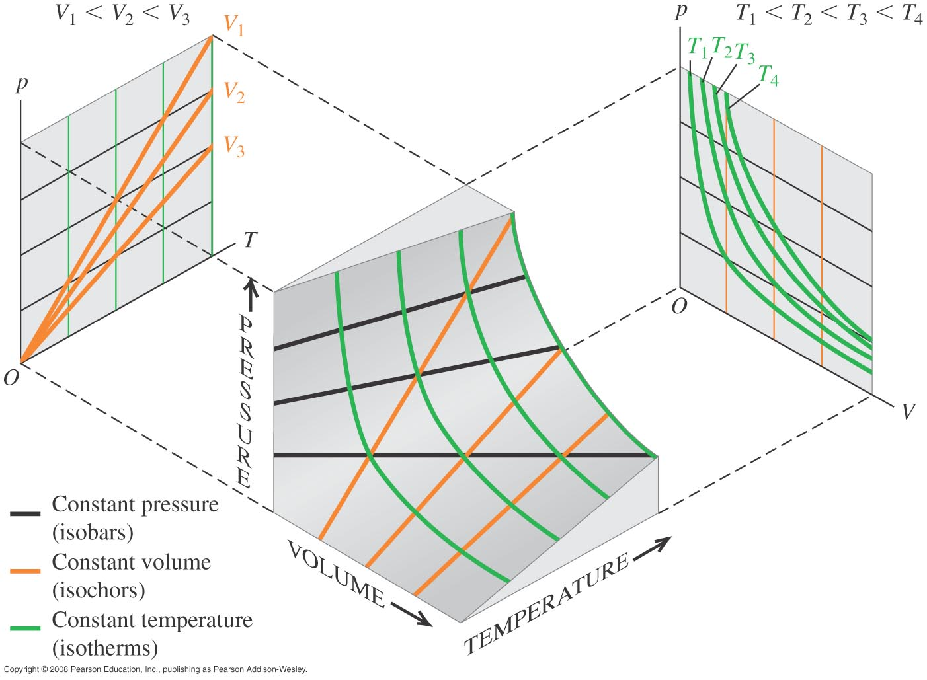
Ideal Gas P, V, T Diagram

Slide 3
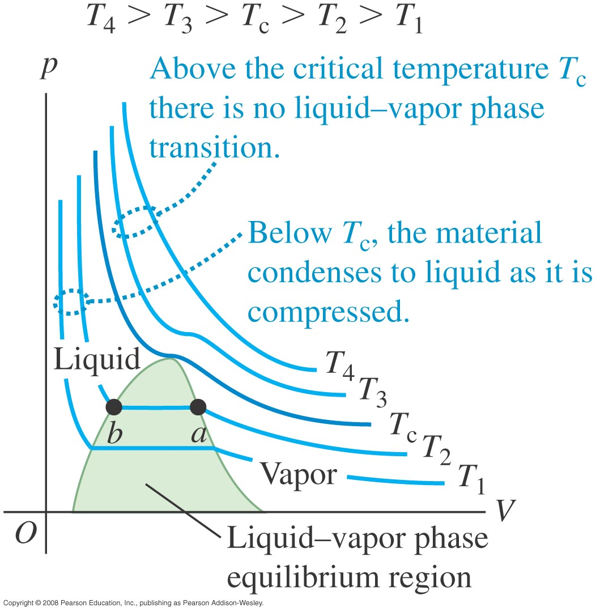
PV Plot with Condensation
Remove heat to compress sample at constant p

Slide 4
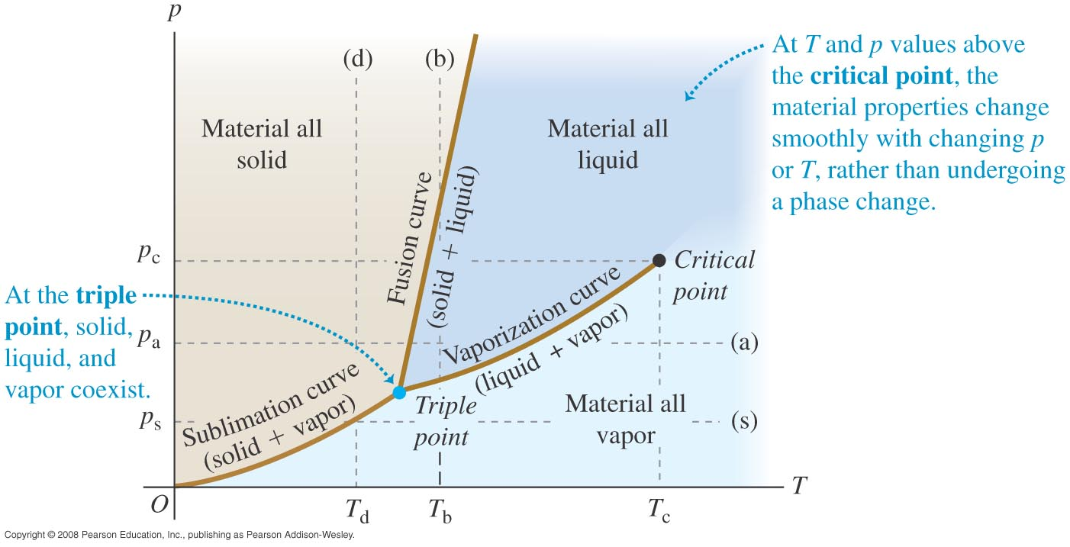
P-T Phase Diagram

Slide 5
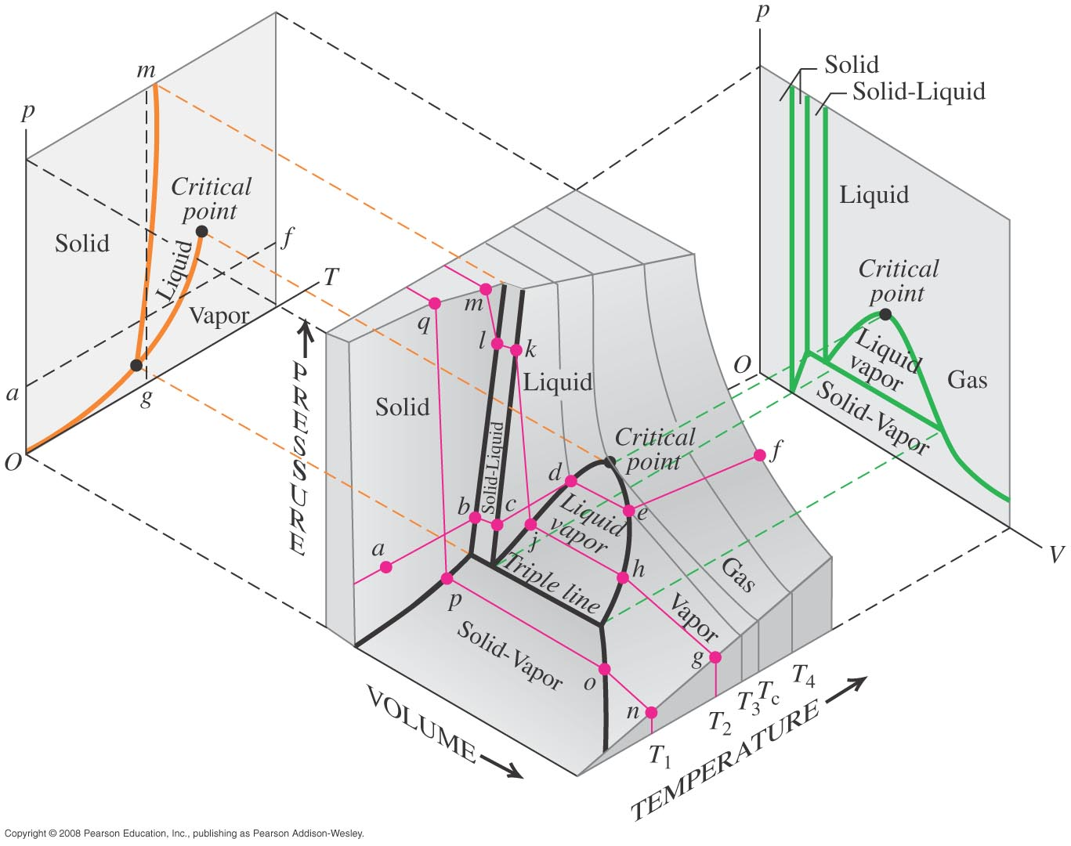
P, V, T Phase Diagram

Slide 6
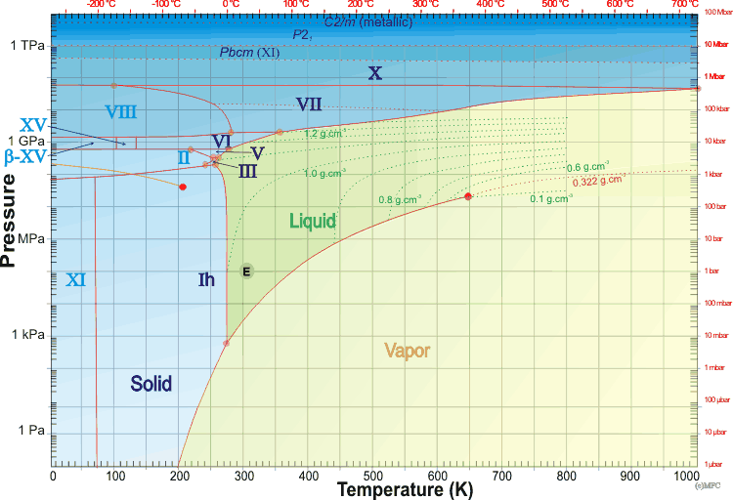
Water Phase Diagram
Source: Martin Chaplin’s Water Structure and Science

