Slide 1
Thermodynamic Paths
energy transfers
§ 18.2–18.3

Slide 2
Definitions
System: bodies and surroundings exchanging energy
State: unique set of p, V, T, (n or N)
(state variables)
Process or path: change in state of a system

Slide 3
Energy Transfers
Q: heat added to the system
surroundings → system
From a temperature difference
W: work done by the system
system → surroundings
Achieved by a volume change

Slide 4
Work W
The surroundings exert pressure on the system.
If the system expands, it does work on the surroundings.
So, W > 0,
and the surroundings do negative work on the system.

Slide 5
What’s the sign?
A diesel engine presses a piston inward on a compression stroke.
What is the sign of Q?
What is the sign of W?

Slide 6
What’s the sign?
A rigid hollow metal sphere filled with a sample of an ideal gas is placed in an ice bath, lowering the gas temperature.
What is the sign of Q?
What is the sign of W?

Slide 7
What’s the sign?
A dark-colored balloon containing air is placed in direct sunlight. It warms and expands.
What is the sign of Q?
What is the sign of W?

Slide 8
Work and Heat
Depend on the path taken between initial and final states.

Slide 9
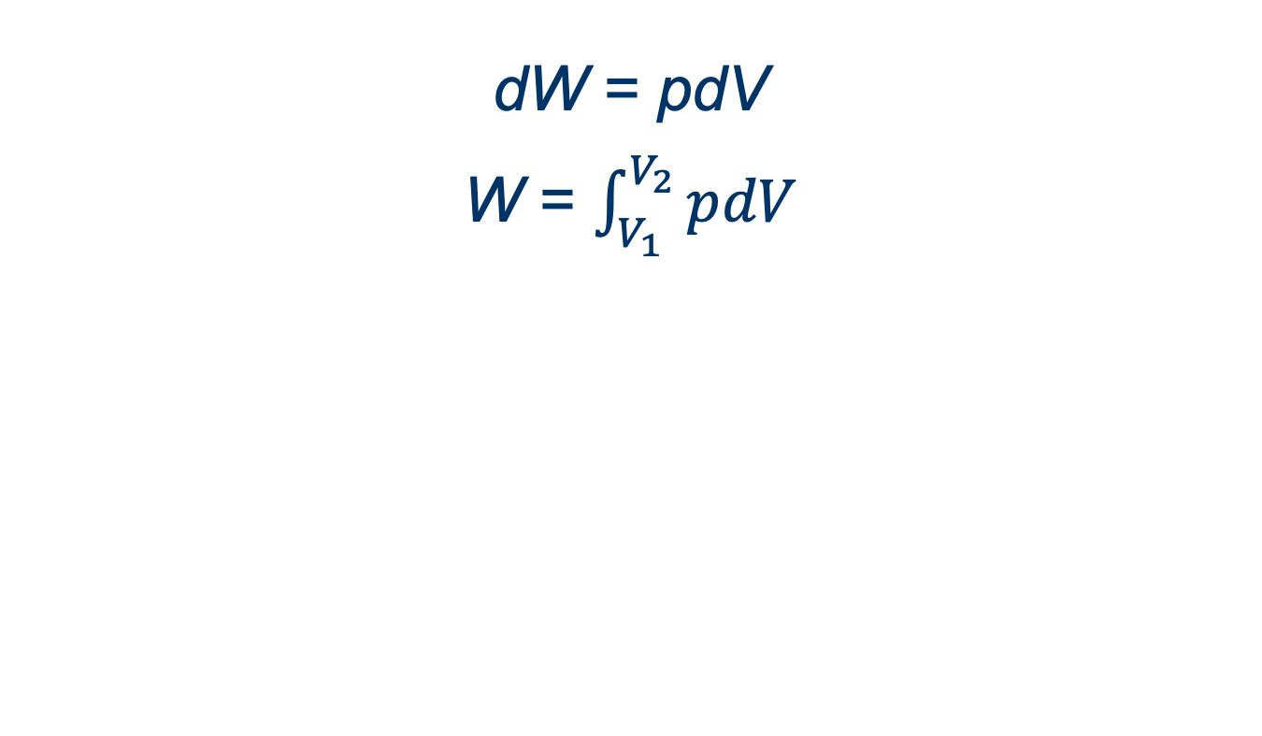
Calculating Work

Slide 10
Constant-pressure Process
∫pdV = p∫dV

Slide 11
Constant-temperature Process
pV = nRT
p = nRT/V
∫pdV = nRT ∫dV/V
W =

Slide 12
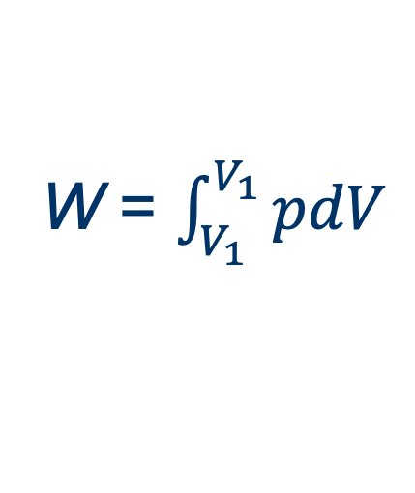
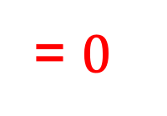
Constant-volume Process

Slide 13
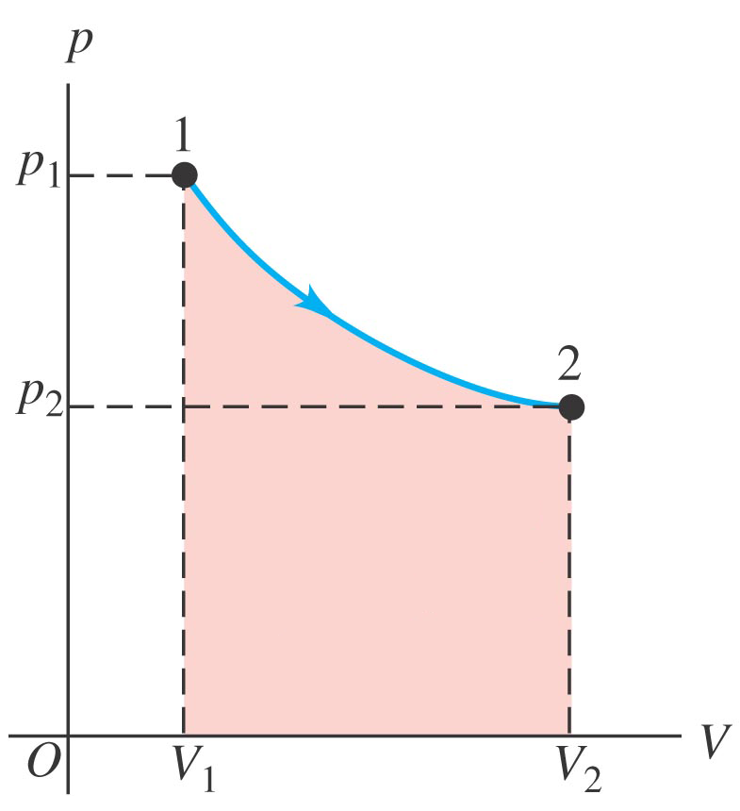
pV Diagrams
W = area under pV curve
Source: Y&F, Figure 19.6a

Slide 14
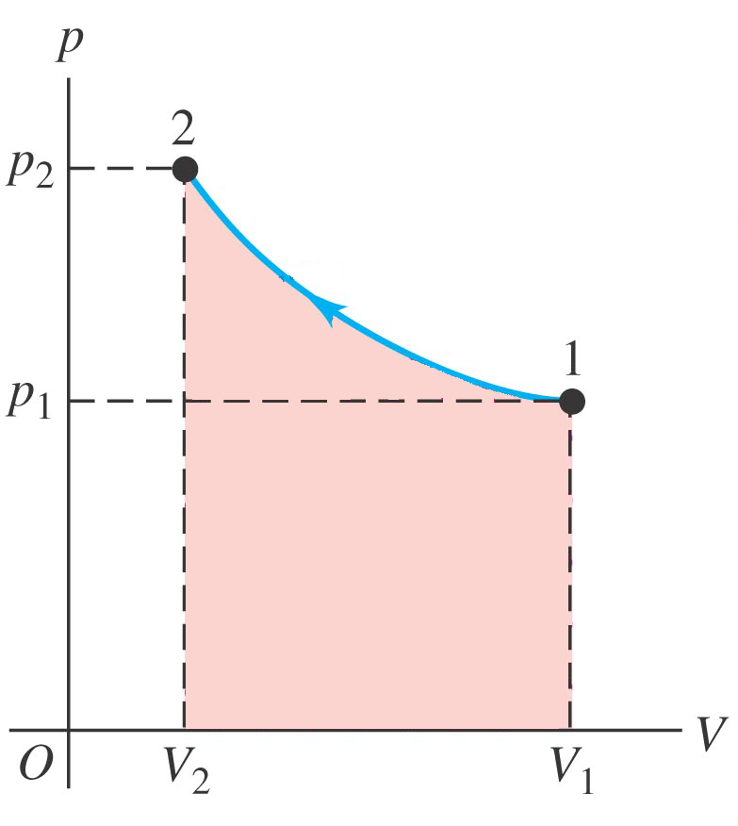
Question
What is this system doing?
Expanding
Contracting
Absorbing heat at constant volume
Absorbing heat at constant pressure
Source: Y&F, Figure 19.6b

Slide 15
Question
What is the sign of the work W for this process?
+
–
0
Cannot be determined
Source: Y&F, Figure 19.6b

Slide 16
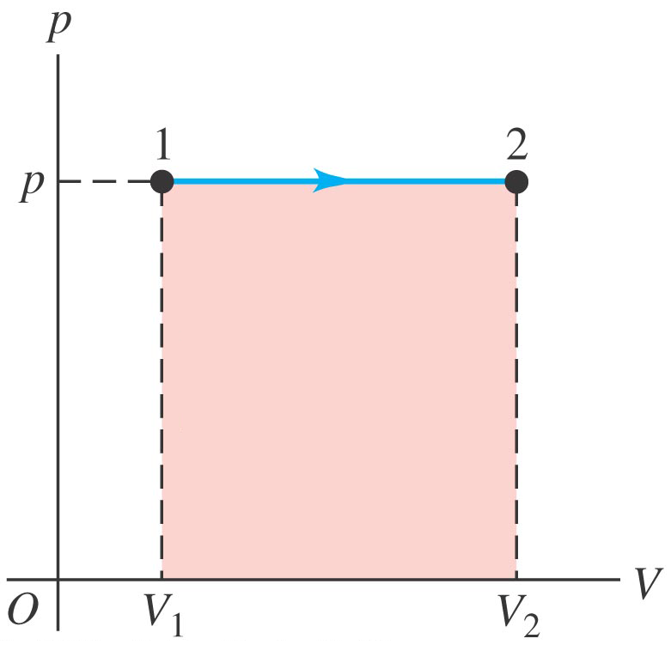
Question
What is this system doing?
Expanding at constant volume
Expanding at constant temperature
Expanding at constant pressure
Source: Y&F, Figure 19.6c

Slide 17
Question
How is the temperature of this system changing?
Increasing
Decreasing
Remaining constant
Cannot be determined
Source: Y&F, Figure 19.6c

Slide 18
Simple Case
Expansion at constant pressure
W = pΔV
Source: Y&F, Figure 19.6c

Slide 19
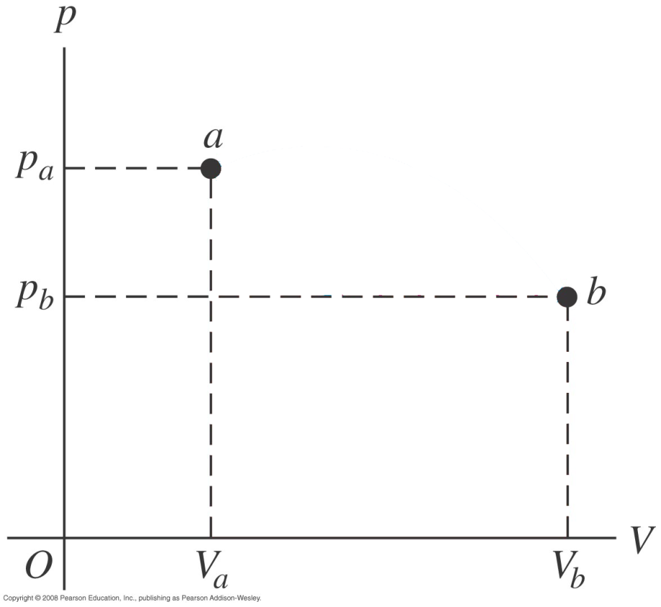
Question
The work done by a thermodynamic system in a cyclic process (final state is also the initial state) is zero.
True.
False.
Source: Y&F, Figure 19.12

Slide 20
Cyclic Process
W ≠ 0
Is the system a limitless source of work?
(Of course not.)
W
Source: Y&F, Figure 19.12

Slide 21
Cyclic Processes
In a cyclic process, the system is the same at the end as it was at the beginning
Energy output must equal energy input

Slide 22
Cyclic Processes
ΔU = U₁ – U₁ = 0
so
Q – W = 0
so
Q = W
Work output = heat input

Slide 23
Work out = Heat in
Does this mean cyclic processes convert heat to work with 100% efficiency?
(Of course not.)
Waste heat is not recovered.

Slide 24
Internal Energy U
U ≡ ΣK_{i} + ΣΣV_{ij}
i
i
j<i
K_{i} = kinetic energy of molecule i wrt com
V_{ij} = intermolecular potential energy of i and j
Does not include potential or kinetic energy of bulk object
Each thermodynamic state has a unique U (U is a state function)

Slide 25
Question
All other things being equal, adding heat to a system increases its internal energy U.
True.
False.

Slide 26
Question
All other things being equal, lifting a system to a greater height increases its internal energy U.
True.
False.

Slide 27
Question
All other things being equal, accelerating a system to a greater speed increases its internal energy U.
True.
False.

Slide 28
Question
All other things being equal, doing work to compress a system increases its internal energy U.
True.
False.

Slide 29
Conservation of Energy
ΔU of a system =
  work done on the system
  +
  heat added to the system

Slide 30
First law of Thermodynamics
ΔU = Q – W
ΔU is path-independent

Slide 31
Types of Processes
cool names, easy rules

Slide 32
Reversible
Both the system and surroundings can be reset to the initial state
Requires no non-conservative processes
  no friction
  no contact between different temperatures
An ideal concept
  not actually possible
  some processes can get close

Slide 33
Constant pressure
“Isobaric”
W = PΔV

Slide 34
Constant Volume
“Isochoric”
W = 0

Slide 35
Constant Temperature
“Isothermal”
Ideal gas: W = nRT ln(V_{f}/V_{i})

Slide 36
No Heat Flow
“Adiabatic”
Q = 0
W: more complicated

