Slide 1
Electric Flux
how many lines?

Slide 2
Electric Flux
Through a closed surface

Slide 3
Electric Flux Φ_{E}
Conceptually, the number of electric field lines passing through a surface
E
Φ_{E} = EA
A = area of the surface

Slide 4
Electric Flux Φ_{E}
Formula Φ_{E} = EA only works when field is normal to the surface
E
Φ_{E} = 0

Slide 5

Electric Flux Φ_{E}
E
θ
Area in profile (projection) is A cos θ
θ = angle of E field from surface normal
Φ_{E} = EA cos θ = E·A
A = $A\hat{n}$ = “Area vector” normal to surface

Slide 6
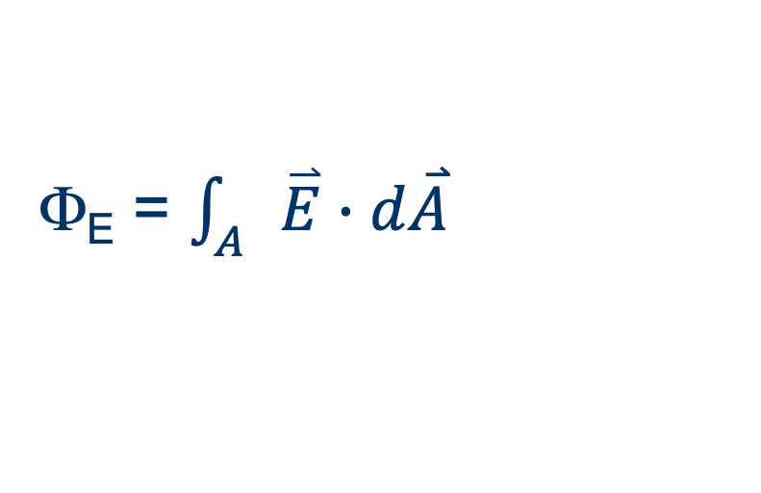
Electric Flux
Integrate over entire surface
Φ_{E} = $\int_{A}{\overset{⃑}{E}∙d\overset{⃑}{A}}$

Slide 7
Surface Integral
Around an entire surface that encloses a region of space
Symbol ∫
Area vector points outward

Slide 8
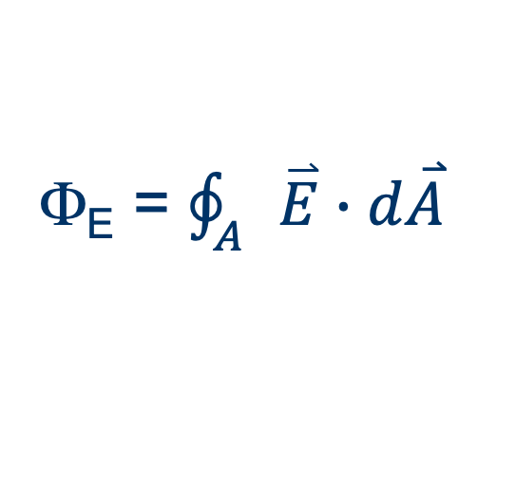
Electric Flux
Integrate over entire surface
Φ_{E} = $\oint_{A}{\overset{⃑}{E}∙d\overset{⃑}{A}}$
Here, Φ_{E} = 0

Slide 9
Gauss’s Law
Flux through an enclosing surface is proportional to charge enclosed
Φ_{E} = q/ε₀
ε₀ = “vacuum permittivity” = 8.85×10^{–12} C²/(Nm²)

Slide 10
Gauss’s law
Use flux to find field around a point charge
The answer should be Coulomb’s law

Slide 11
Field of a Point Charge
What is area A of spherical shell?
Φ_{E} = Q_{in}/ε₀ = EA
Find E

Slide 12
Field around a Point Charge
Shell Area = 4πr²
Φ_{E} = q/ε₀ = EA
+q
q
q
E =
=
R
ε₀A
ε₀4πr²
q
=
4πε₀ r²
kq
1
=
if k =
r²
4πε₀

Slide 13
Gauss’s Law Example
Infinite line of uniform charge density (Q/L) = λ
Cylindrical surface with charge on axis
Area of surface = 2πrL + ends
Q_{in} = Lλ
Φ_{E} = Q_{in}/ε₀ = Lλ/ε₀
Φ_{E} = E(2πrL)
Lλ/ε₀ = E(2πrL)
1
λ
E =
2πε₀
r
Q

Slide 14
Gauss’s Law Example
Infinite plate of uniform charge density (Q/A) = σ
Area of surface = 2A + edges
Q_{in} = Aσ
Φ_{E} = Q_{in}/ε₀ = Aσ/ε₀
Φ_{E} = E(2A)
Aσ/ε₀ = E(2A)
E = ½ σ/ε₀
Q

Slide 15
More Gauss’s law examples
Aspherical shell of uniform charge density
Field inside
Field outside
Field within a sphere of uniform charge density
Charge distribution in a conductor
Field around charge at center of a neutral, hollow conducting sphere

