Slide 1
Monte Carlo Integration
Random area sampling

Slide 2
Monte Carlo Integration
Enclose the function $f(x)$ in a box
Randomly select N points in the box
  uniform distribution
Count the number of points n under $f(x)$
0
a
b

Slide 3
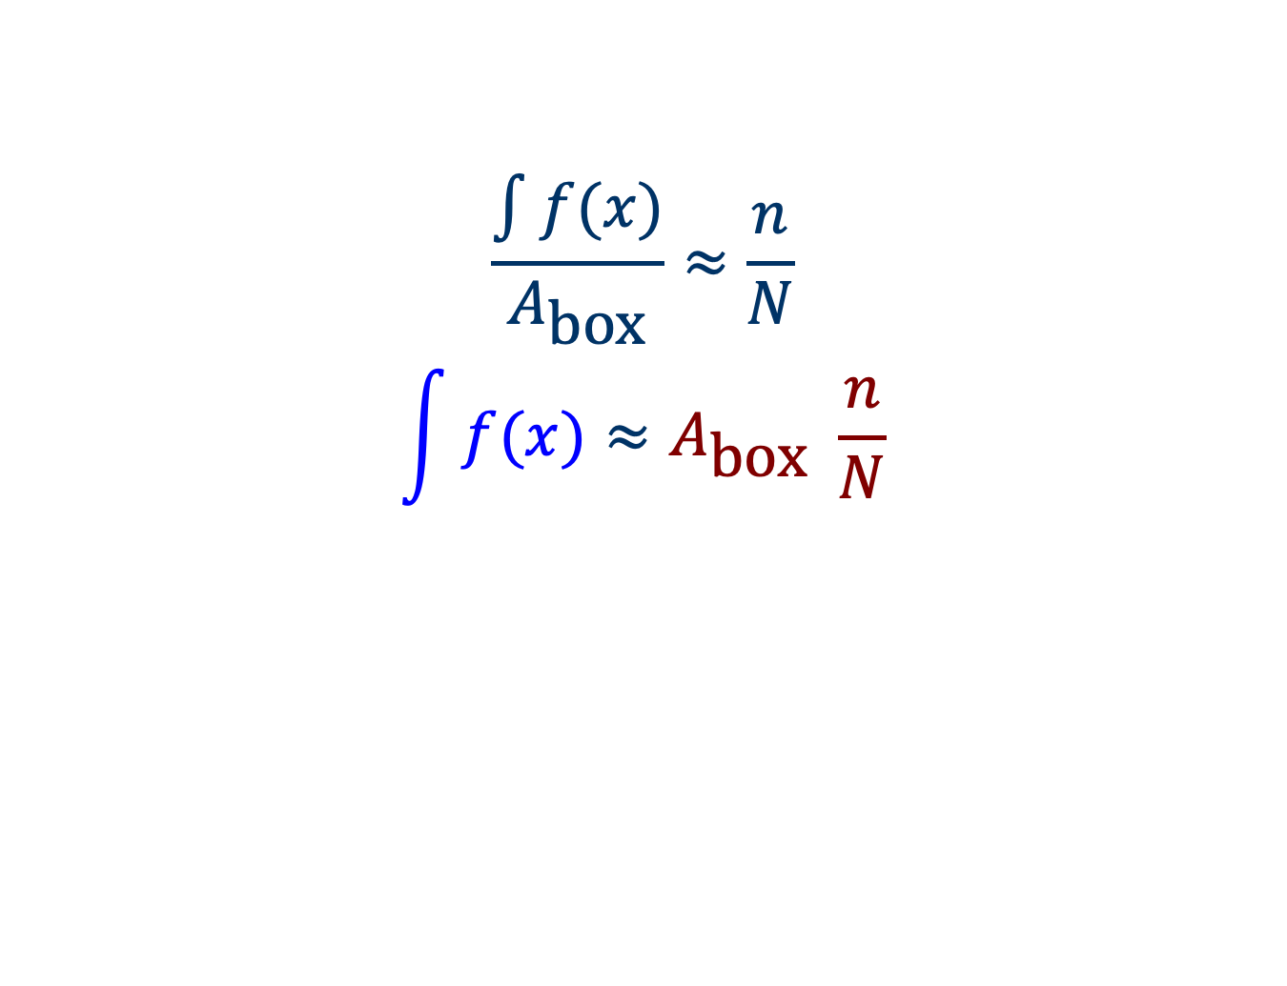
Monte Carlo Integration
$$\frac{\int{f(x)}}{A_{\text{box}}}≈\frac{n}{N}$$
$$\int{f(x)}≈A_{\text{box}} \frac{n}{N}$$
0
a
b

Slide 4
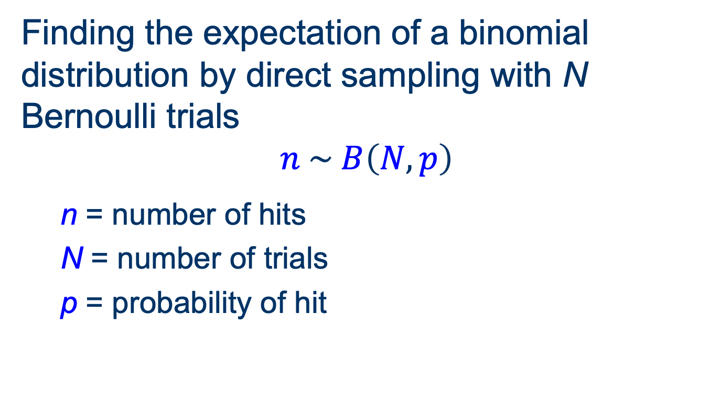
Monte Carlo Integration
Finding the expectation of a binomial distribution by direct sampling with N Bernoulli trials
$$n \sim B\left(N,p\right)$$
  n = number of hits
  N = number of trials
  p = probability of hit

Slide 5
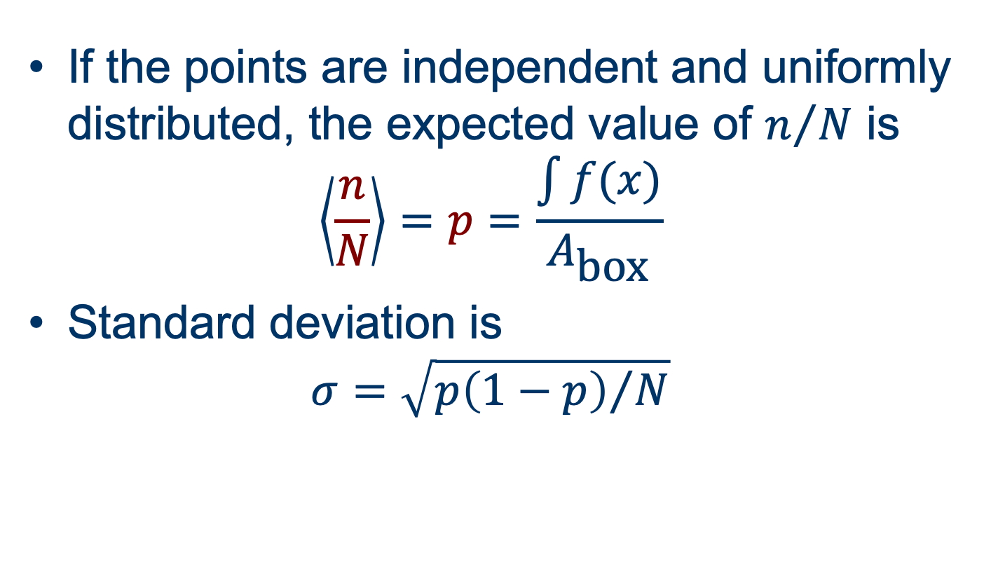
Monte Carlo Integration
If the points are independent and uniformly distributed, the expected value of $n/N$ is
$$\left\langle \frac{n}{N}\right\rangle =p=\frac{\int{f(x)}}{A_{\text{box}}}$$
Standard deviation is
$$σ=\sqrt{{p\left(1−p\right)}/N}$$

Slide 6
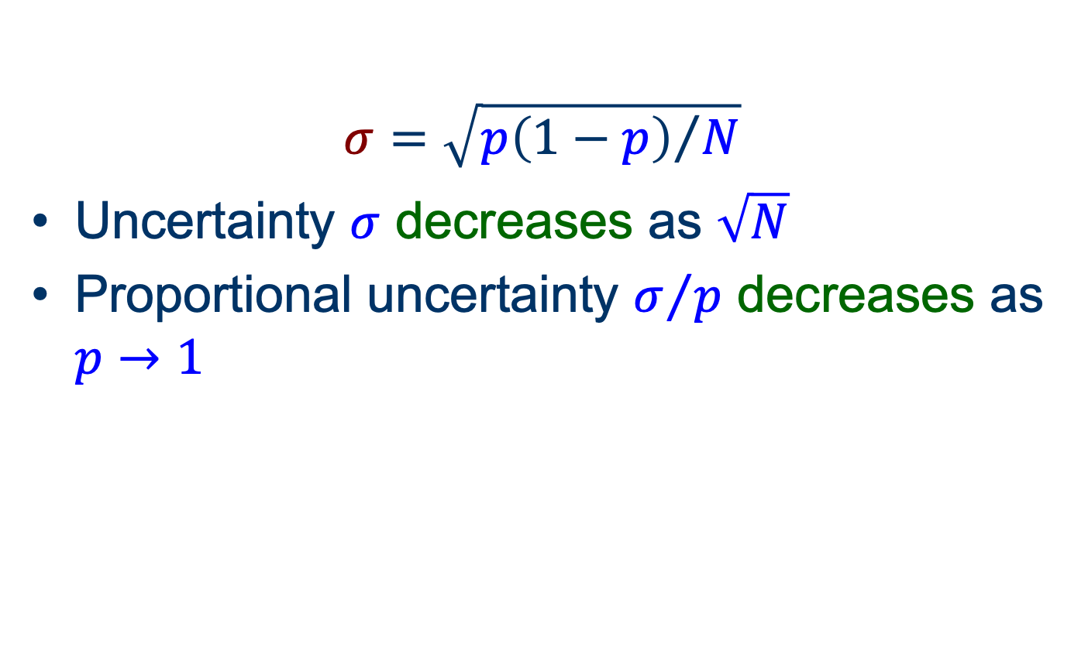
Monte Carlo Integration
$$σ=\sqrt{{p\left(1−p\right)}/N}$$
Uncertainty $σ$ decreases as $\sqrt{N}$
Proportional uncertainty $σ/p$ decreases as $p→1$

Slide 7
Mean Value Method
Refining Monte Carlo

Slide 8
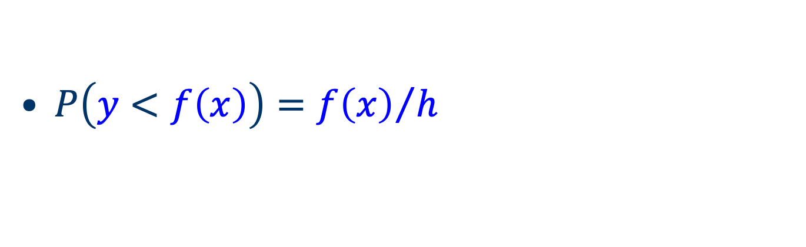
Mean Value Method
$P\left(y<f\left(x\right)\right)={f\left(x\right)}/h$
Don’t need to randomly sample y’s
h
0
a
x
b

Slide 9
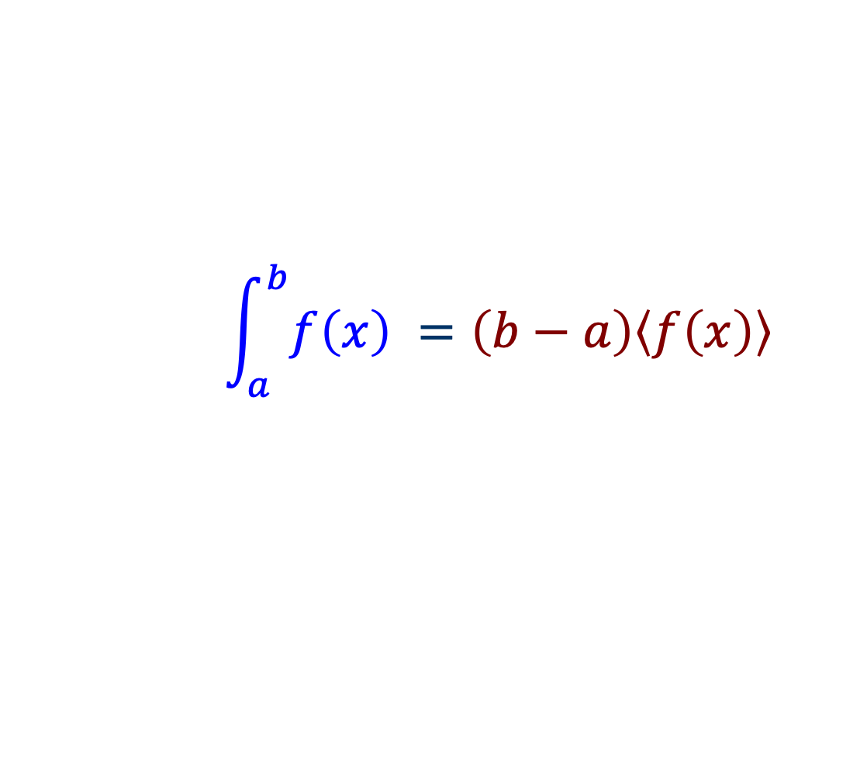
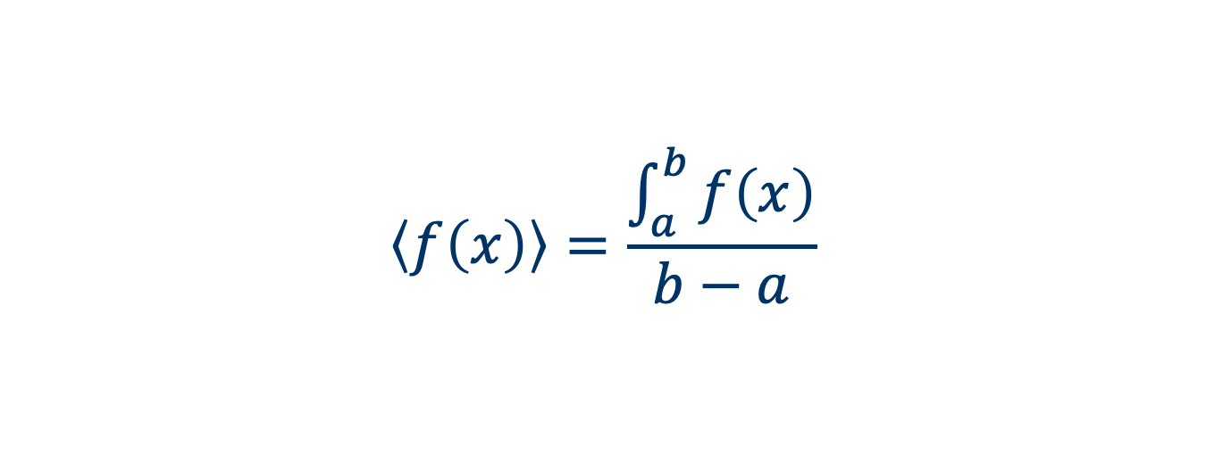
Mean Value Method
$$\left\langle f\left(x\right)\right\rangle =\frac{\int_{a}^{b}{f\left(x\right)}}{b−a}$$
So
$$\int_{a}^{b}{f\left(x\right)} =\left(b−a\right)\left\langle f\left(x\right)\right\rangle$$
h
0
a
x
b

Slide 10
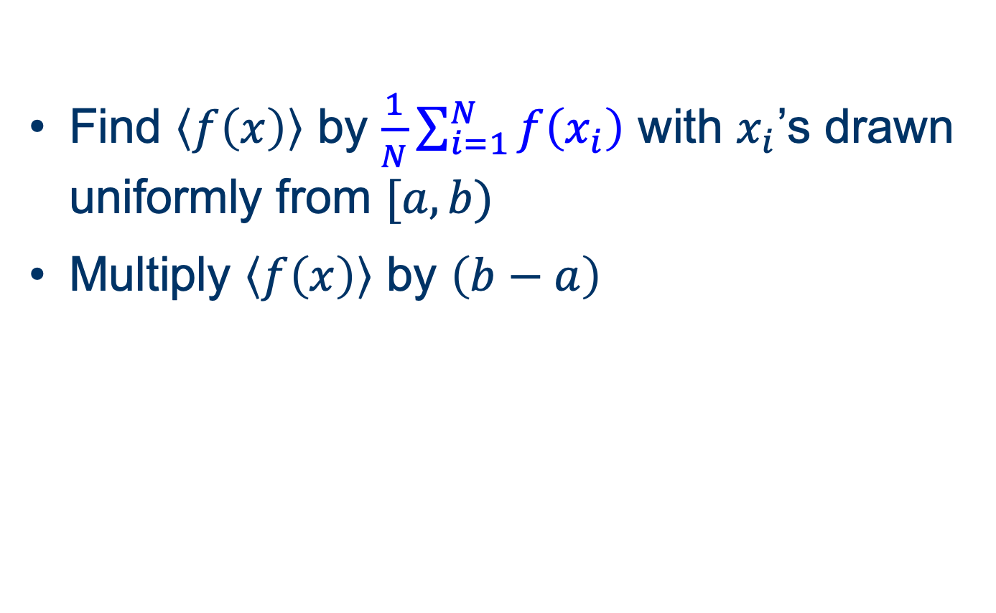
Mean Value Method
Find $\left\langle f\left(x\right)\right\rangle$ by $\frac{1}{N}\sum_{i=1}^{N}{f\left(x_{i}\right)}$ with $x_{i}$’s drawn uniformly from $[a,b)$
Multiply $\left\langle f\left(x\right)\right\rangle$ by $\left(b−a\right)$

Slide 11
Multidimensional Integrals
Inside rather than under

Slide 12
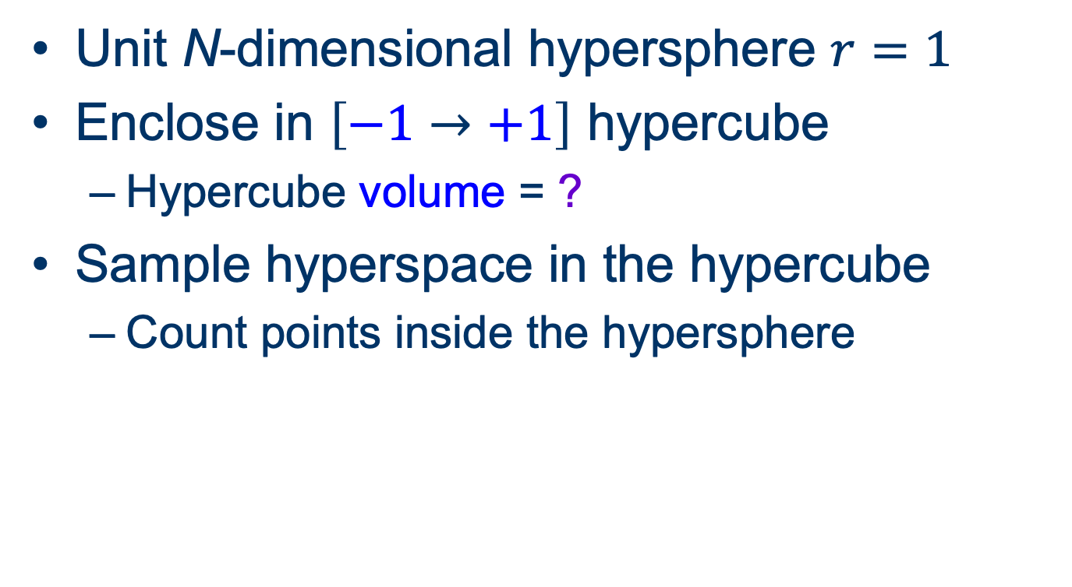
Exercise: Hypersphere volume
Unit N-dimensional hypersphere $r=1$
Enclose in $\left[−1→+1\right]$ hypercube
  Hypercube volume = ?
Sample hyperspace in the hypercube
  Count points inside the hypersphere

